Slide 1



Renewable Energy: A Sustainable Future
Frantisek Lizal
Energy institute

Slide 2


Slide 3


Resources
Sørensen, Bent. (2017). Renewable Energy - Physics, Engineering, Environmental Impacts, Economics and Planning (5th Edition). Elsevier.
Twidell, John. (2022). Renewable energy resources (4th edition). Routledge.
AR6 Synthesis Report: Climate Change 2023 — IPCC. https://www.ipcc.ch/report/sixth-assessment-report-cycle/
Our world in data - https://ourworldindata.org/
Figures: Midjourney

Slide 4
Introduction - Perspectives on Energy Resources
The penetration of renewable energy into the energy system of human settlements on Earth has, from one point of view, always been nearly 100%.
The energy system experienced by the inhabitants of the Earth is dominated by the environmental heat associated with the greenhouse effect, which captures solar energy and stores it within a surface-near sheet of topsoil and the atmosphere around the Earth.
Only 0.02% of this energy system is currently managed by human society (Sørensen, Bent. (2017). Renewable Energy - Physics, Engineering, Environmental Impacts, Economics and Planning (5th Edition). Elsevier.)

Slide 5
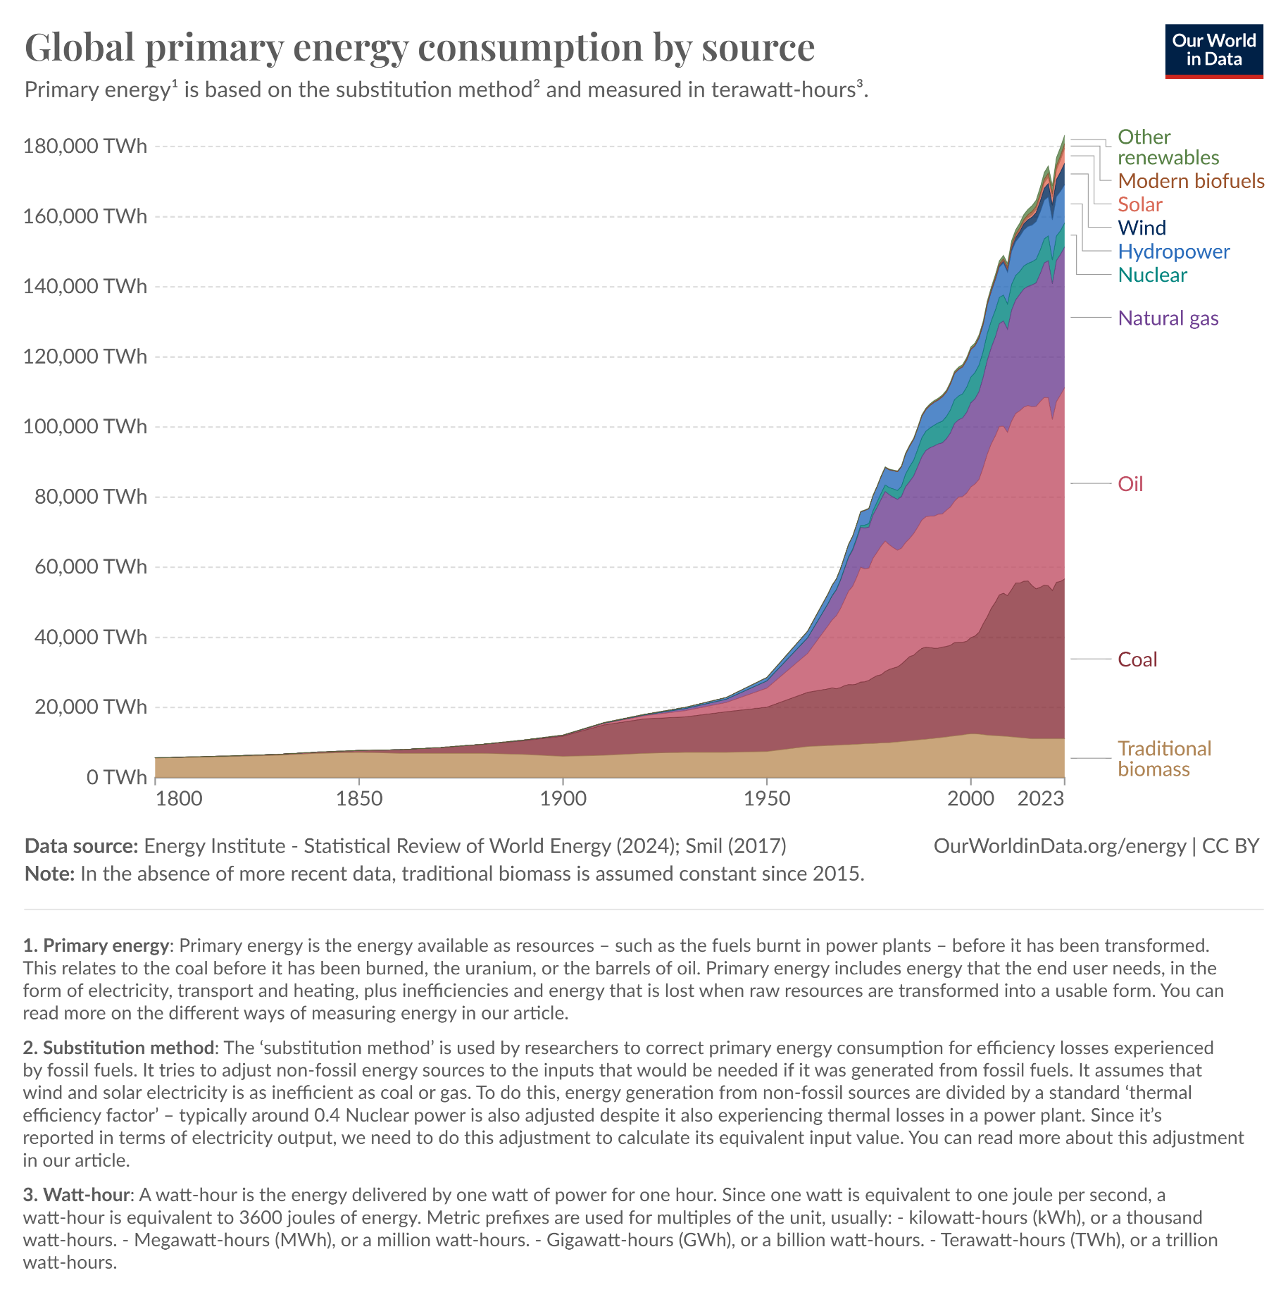
Hannah Ritchie, Pablo Rosado and Max Roser (2020) - “Energy Production and Consumption” Published online at OurWorldinData.org. Retrieved from: 'https://ourworldindata.org/energy-production-consumption' [Online Resource]

Slide 6
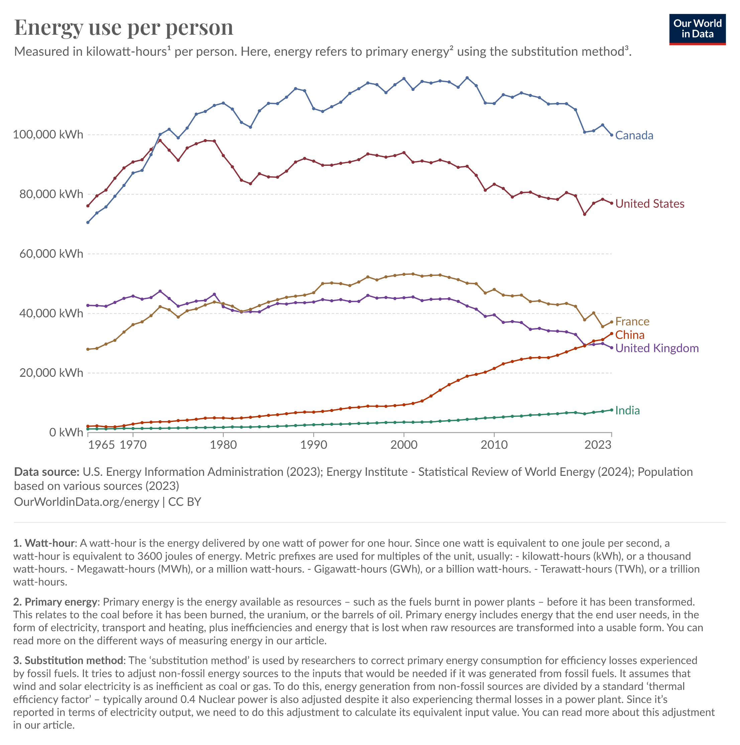

Slide 7
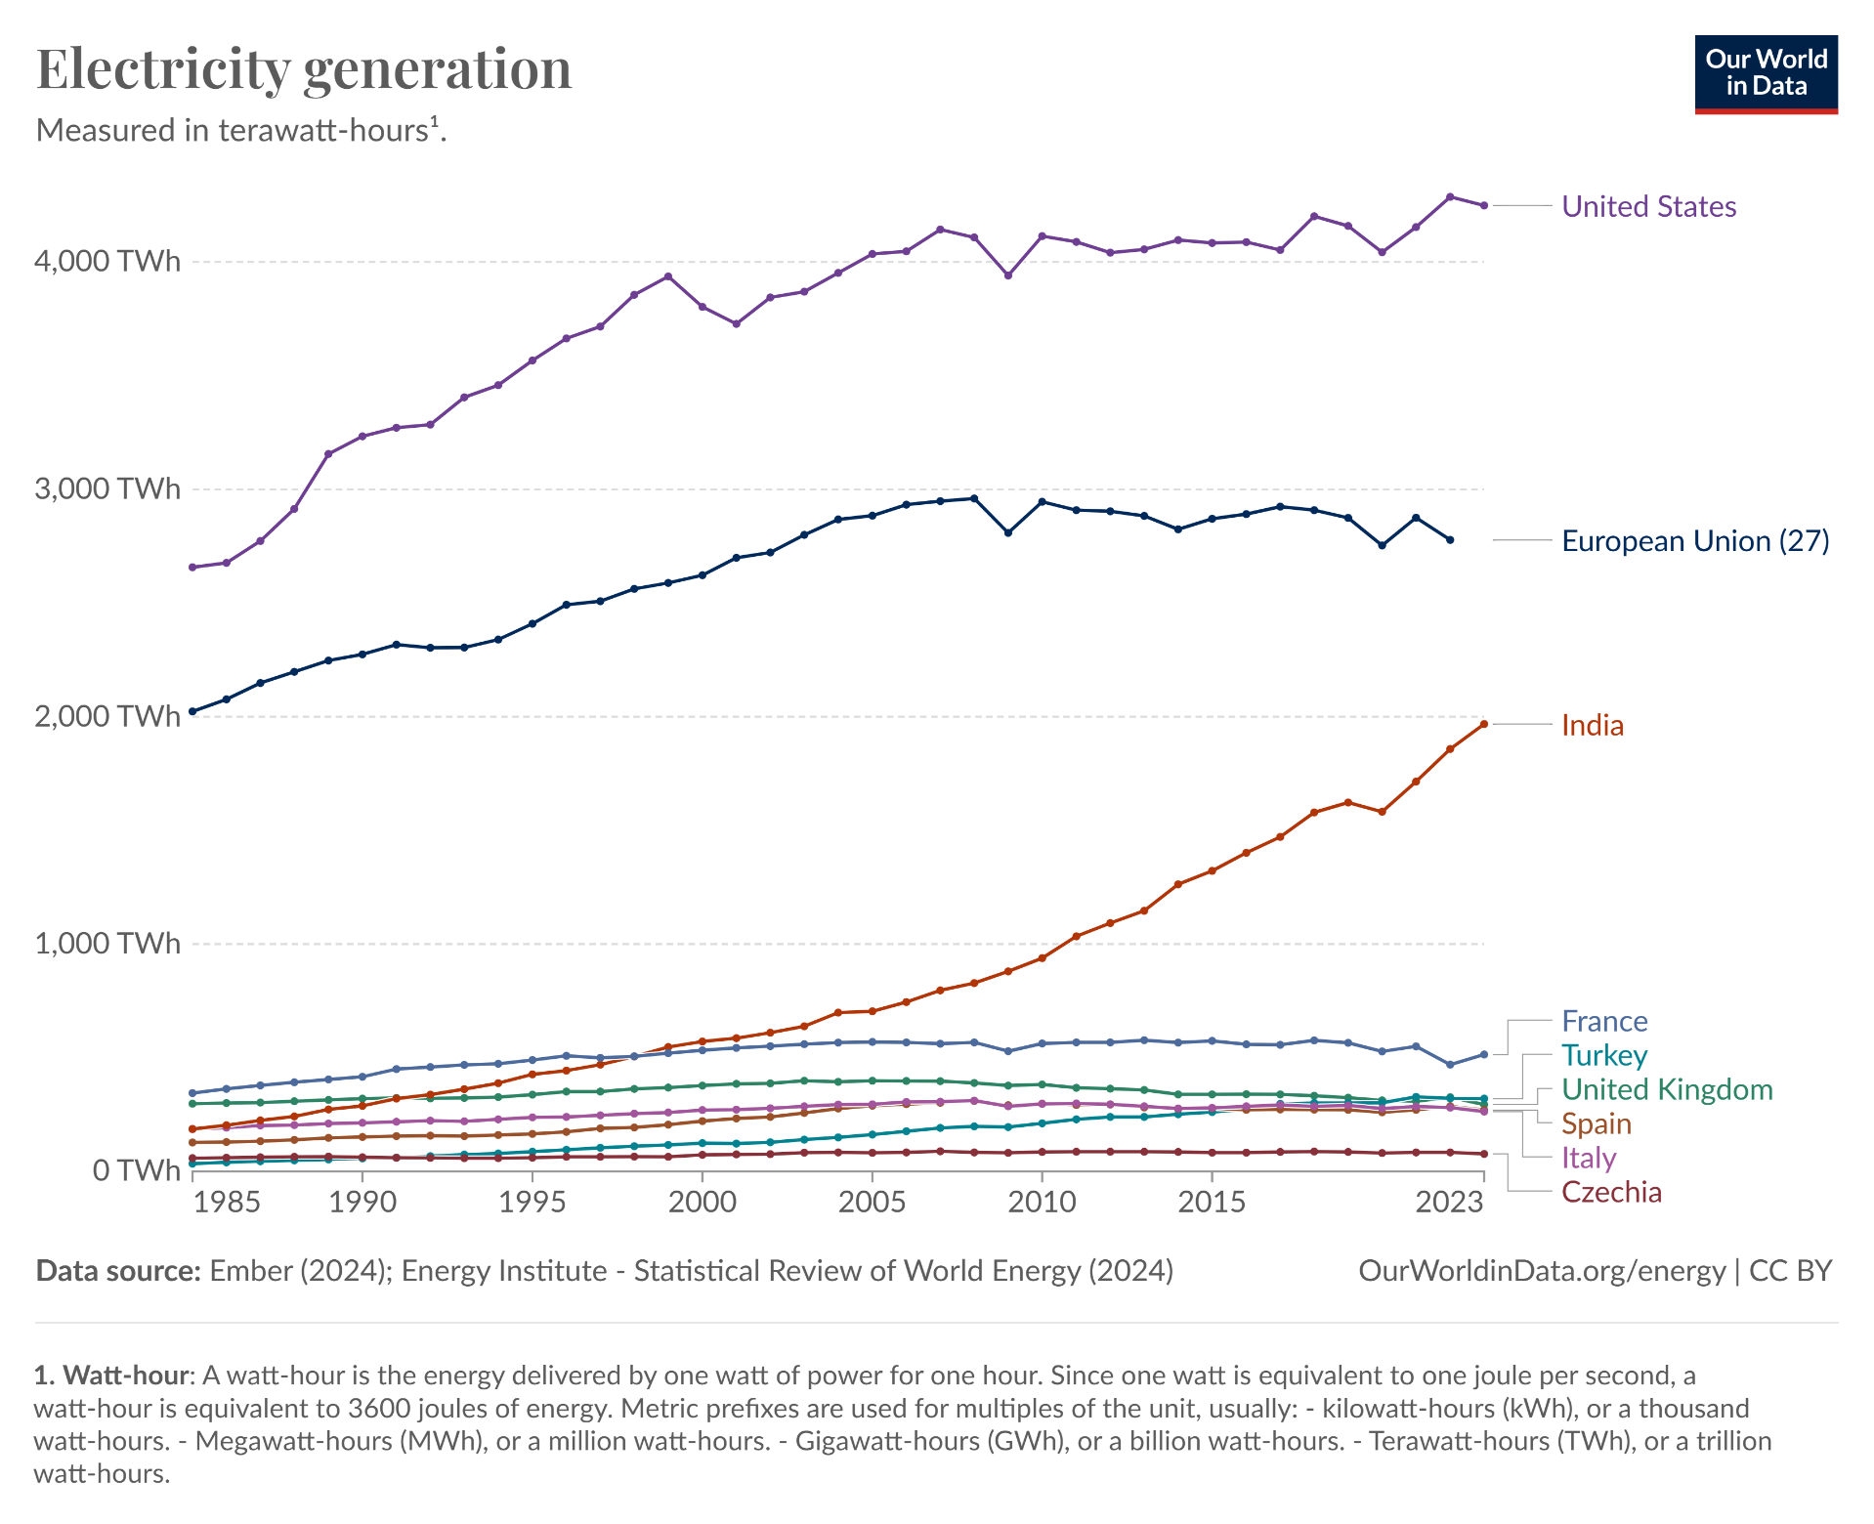

Slide 8

The Human-Managed 0.02%: A Closer Look
Within this economically managed part of the energy sector, renewable energy sources currently provide about 25% of the energy supplied.
A large part of this renewable energy is in the form of biomass energy, either in food crops or in managed forestry.
Other sources of renewable energy exploited include hydro, wind, and solar.
The dominant direct energy sources are still fossil fuels, despite the fact that they are depletable and a major cause of climate change, as well as of frequent national conflicts.

Slide 9
Key Renewable Energy Technologies and Their Current Status
Hydropower: A substantial source, but its use is no longer growing very fast, due to environmental limits identified in many locations with potential hydro resources.
Passive solar heating: a key feature of building design throughout the world, but active solar heat or power panels are still at a minute level of penetration, although growing fast.
Wind: Has both a passive and an active role. Active power production by wind turbines is today a very rapidly growing energy technology in many parts of the world.
Additional renewable energy technologies: so far with fairly modest global penetration, include gaseous or liquid biofuels and geothermal power and heat.

Slide 10
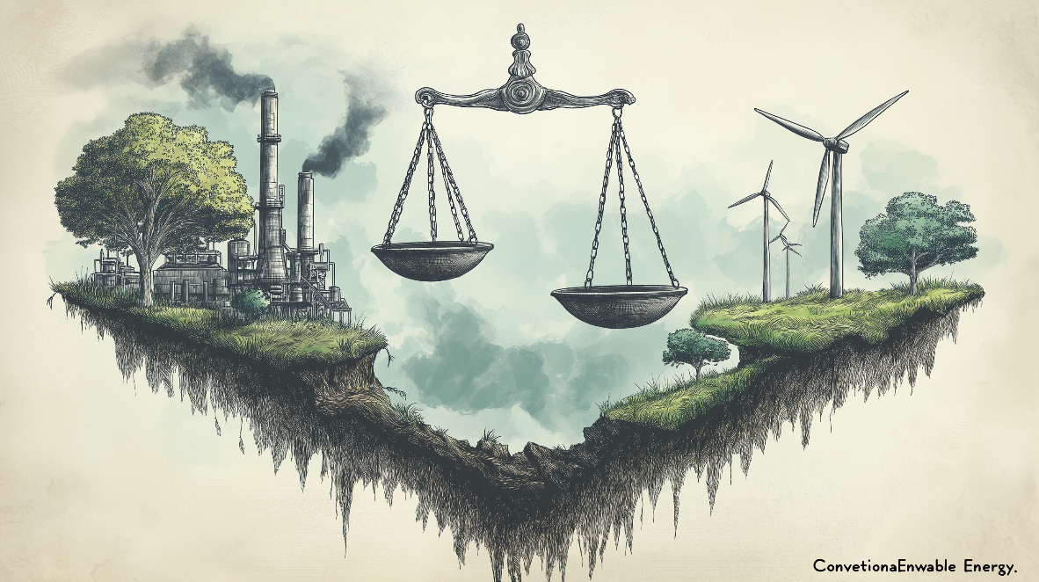
Market Drivers: Beyond Consumer Demand
Renewable energy markets comprise both consumer markets and markets driven by government demonstration programs and policies aimed to diminish market distortions.
The occasional initial subsidies were part of an industrial policy aimed at helping new industry through market stimulation.
Compensation for market distortions addresses the fact that conventional energy industries are not fully paying for the negative environmental effects of their products.

Slide 11
The Complexity of External Costs
This is a complex issue, partly because of the difficulty in exact determination of external costs and partly because most countries already levy taxes on energy products that may in part be seen as contributing toward paying for any environmental damage.
Often they are just a government revenue not specifically used to offset the negative effects associated with using fossil or nuclear fuels

Slide 12
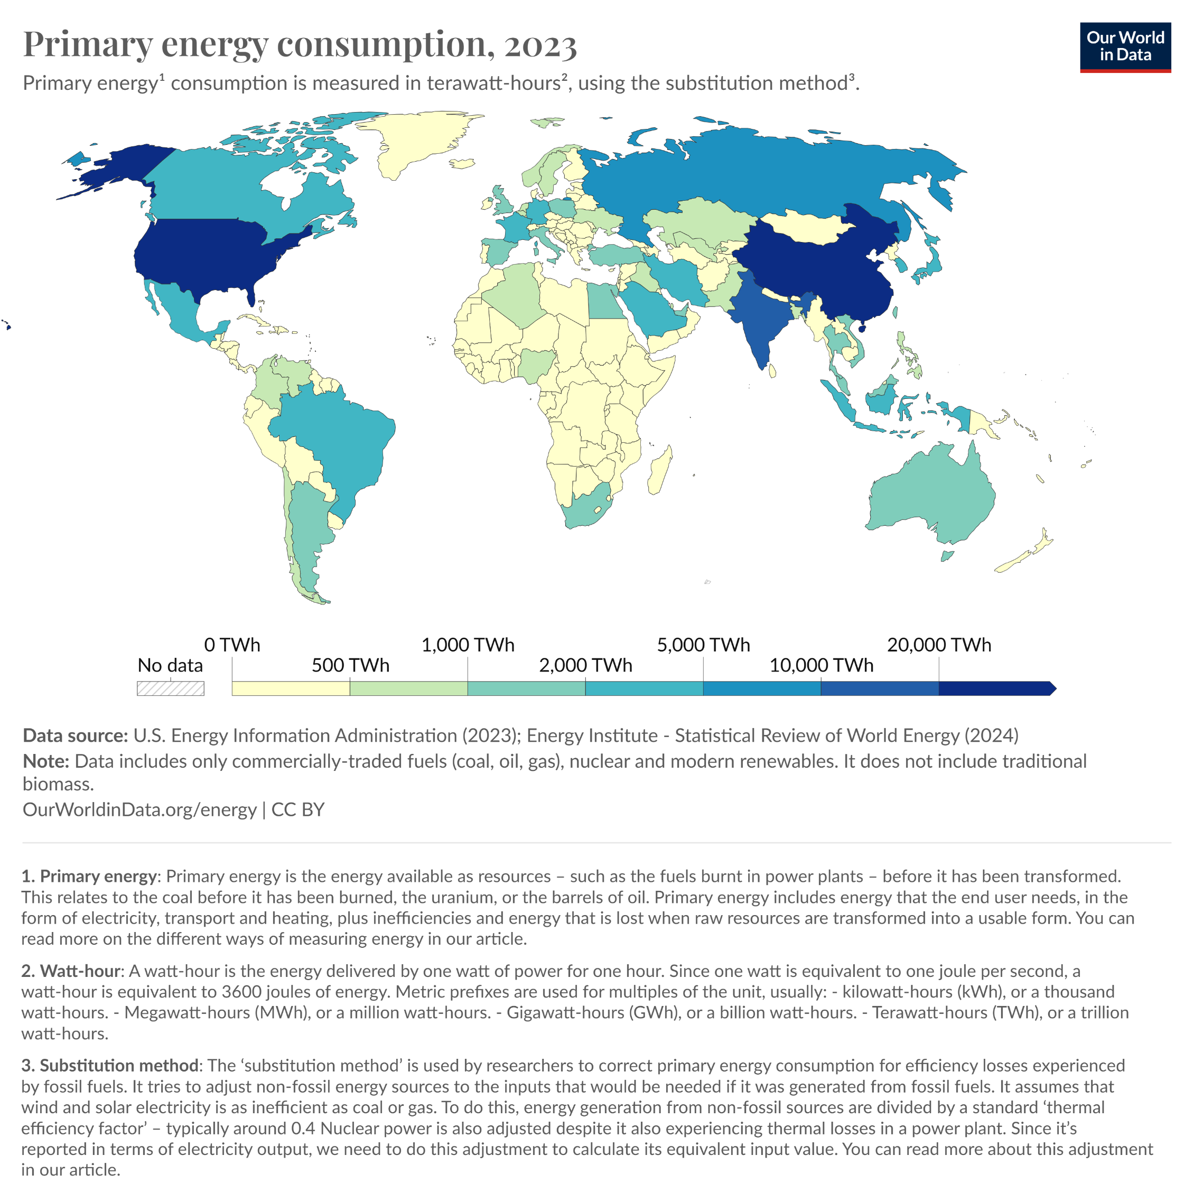

Slide 13
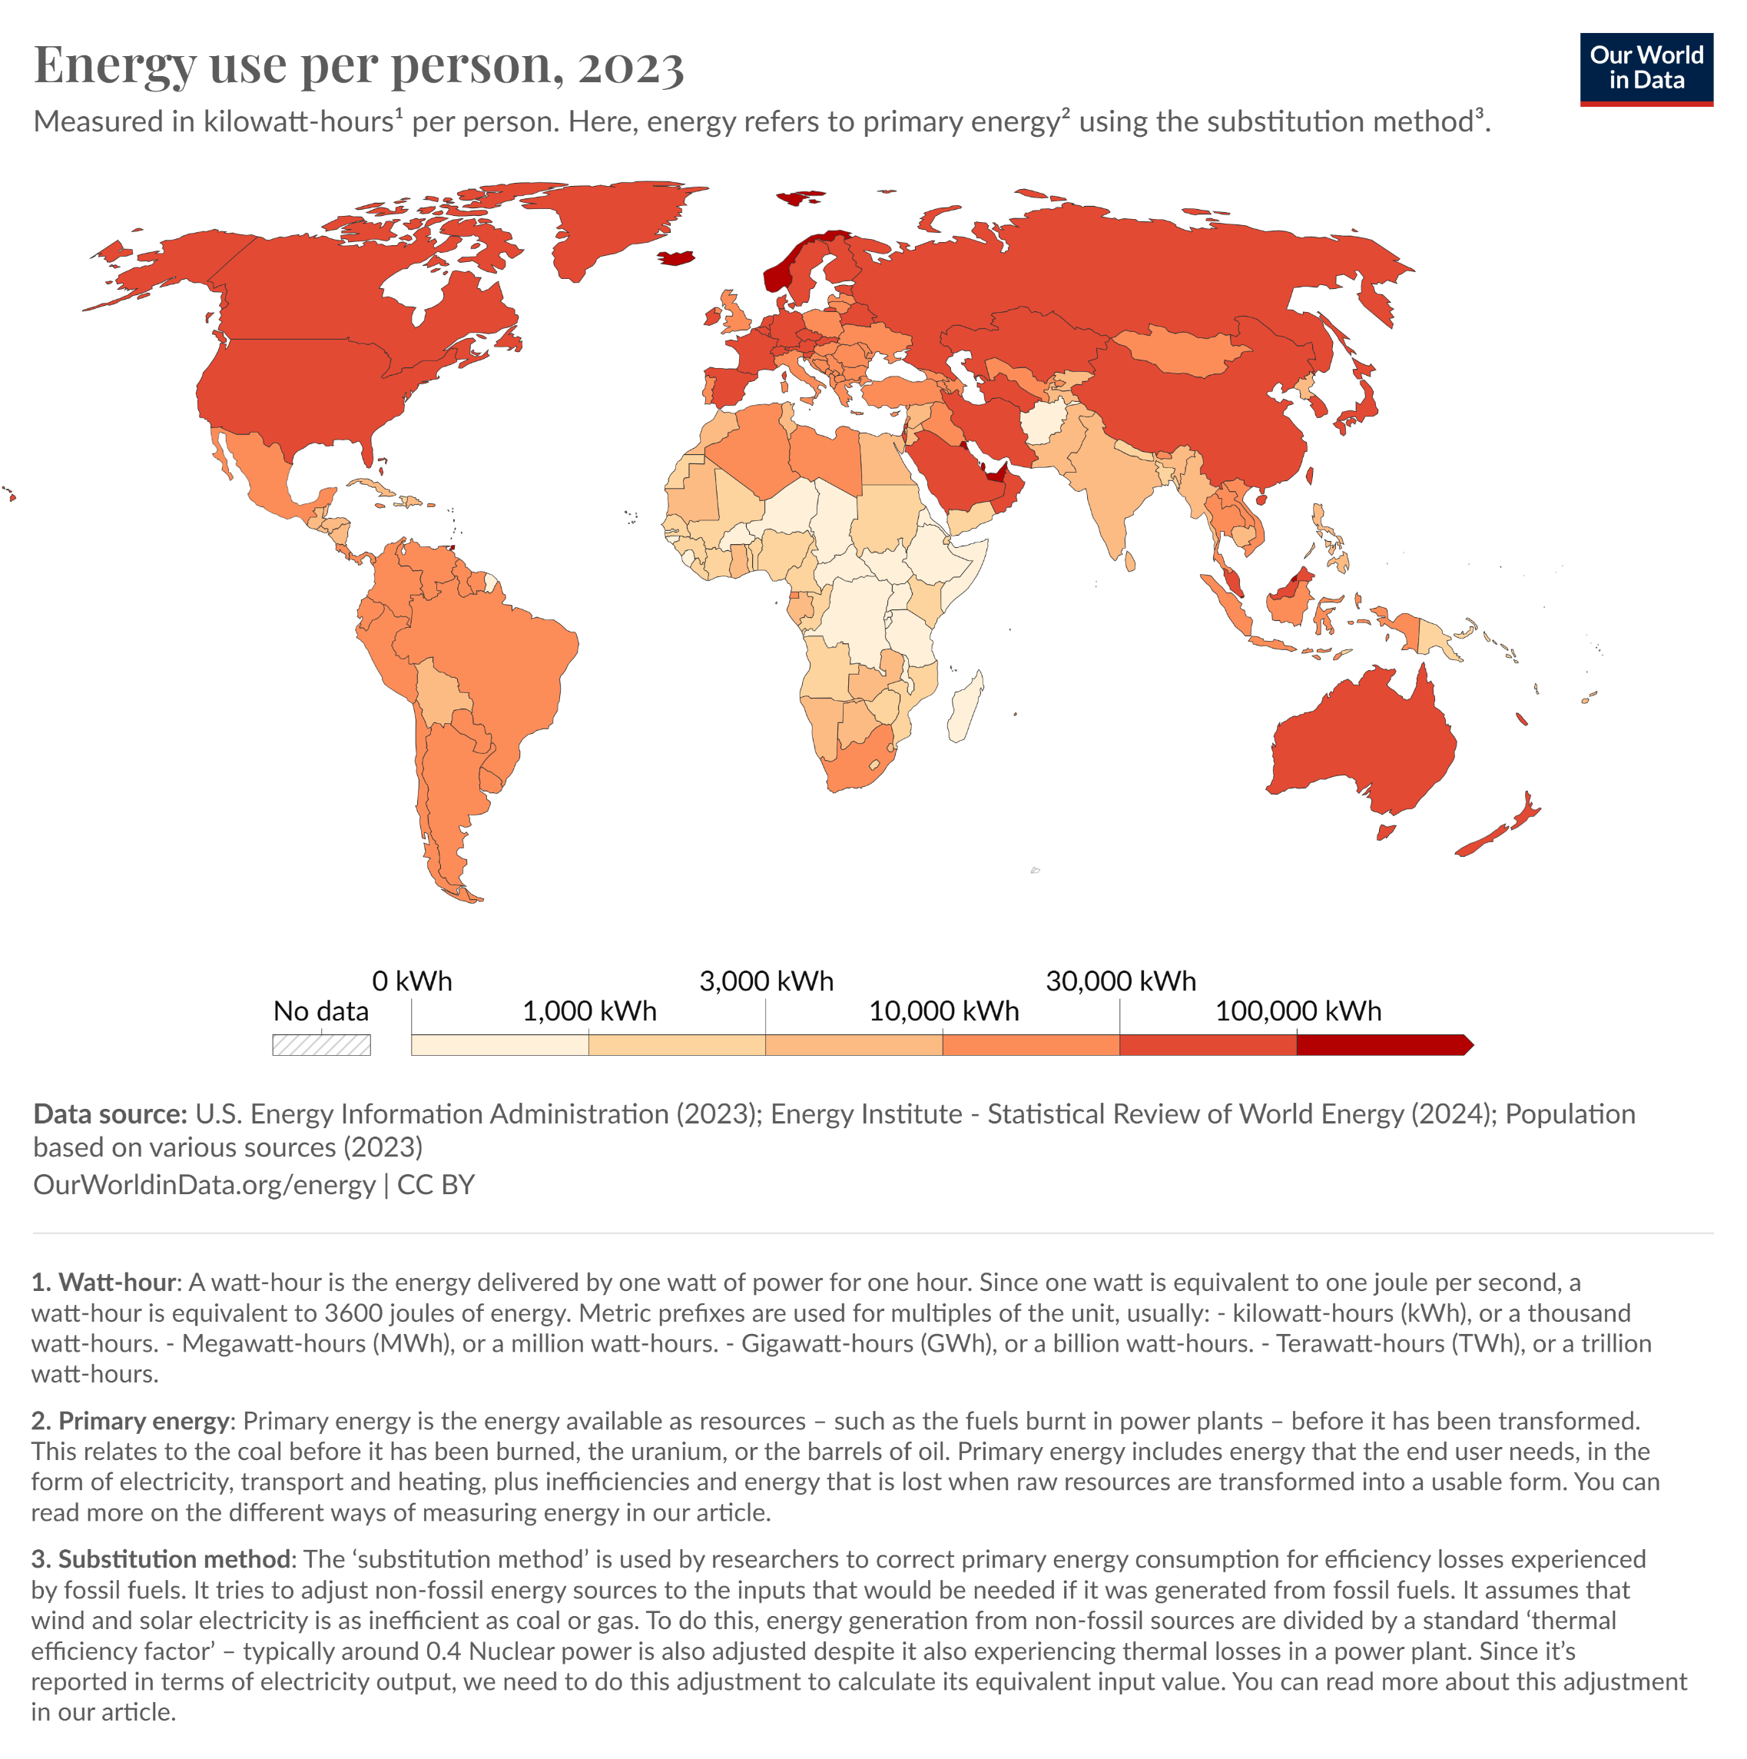

Slide 14
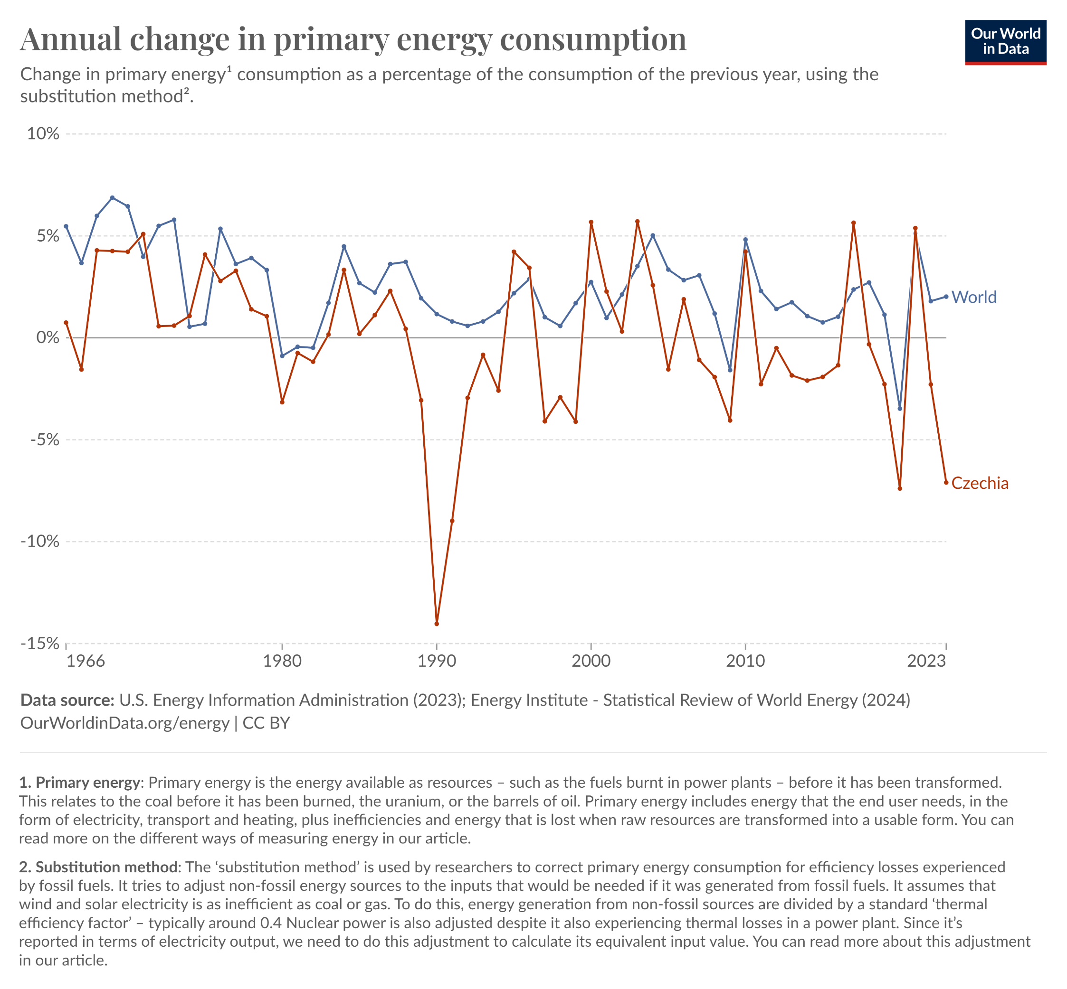

Slide 15
The Continued Dominance of Biomass and Its Implications
The traditional use of biomass for combustion is still the dominating use of renewable energy.
The claim of CO2-neutrality made, e.g., by EU countries and in global climate negotiations is false, because the time between CO2 assimilation by trees and release to the atmosphere is of the order of a hundred years.
Combustion in large facilities in developed countries largely avoids the pollution from biomass burning by use of tall stacks and electrostatic filters, but of course cannot avoid the CO2 emission impacts.

Slide 16
Other Renewables – numbers valid for 2013
Hydropower: 50 W/cap.
Geothermal power: only in part can be classified as renewable.
Liquid biofuels: 11 W/cap. (up from 2.3 W/cap. in year 2000).
Solar heating: 4.4 W/cap. (compared with just 0.1 W/cap. by the year 2000).
Tidal power: has stayed below 0.01 W/cap.

Slide 17
Diverse Market Characteristics of Renewable Energy
The market characteristics of the various renewable energy forms exhibit differences linked to the nature of each source.
For food energy, the price is influenced by population size, by variations in production due to climatic variations, by the choices made in regard to area use, by livestock holdings, by fish quotas, and by the competitive behavior of the food processing and marketing industry.

Slide 18
Food vs. Energy: An Economic Perspective
The current wholesale price of cereals like rice is in the low end of the interval 0.8-2.5 US$ per kWh, while the wholesale price of typical meat and dairy products is about 1.25 $ per kWh.
Consumer retail prices are typically some five times higher than the bulk prices here quoted. This is some 20 times the current consumer price of a kWh of electricity produced from fossil fuels.
Sometimes surpluses are dumped on the energy market at very low prices.

Slide 19
Costs of Biomass Waste, Fuelwood, and Other Renewables (2013)
Wholesale market prices for biomass waste and fuelwood range from not much more than 1 cents per kWh of “burning value,” in India to 2-3 c/kWh in industrialized countries.
The production cost of biogas is 6-11 c/kWh.
The cost of wind power is 3-7 c/kWh (depending on wind conditions).
The cost of photovoltaic solar power is 6-60 c/kWh. The photovoltaic market enjoys substantial public start-up subsidies.

Slide 20
Comparing Costs: Hydropower and Fossil Fuels (2013)
Hydropower costs 2-10 c/kWh.
Coal- and gas-based power costs about 5-9 c/kWh to produce (depending on cleaning features).
To all costs given above one should add the cost of distribution, and, in many countries, there are further taxes and environmental externality payments, leading in some cases to customer prices above 30 c/kWh.

Slide 21
Fossil Fuel Price Volatility and the Role of Externalities
For fossil fuels such as oil and natural gas, current production costs vary from very small figures at some Middle East wells to over 3 c/kWh from offshore facilities or from low-grade resources such as shale and tar sand.
The sales price is not strongly coupled to production prices, but is determined by market and political considerations.
Refined products like gasoline are currently sold at prices around 7 c/kWh, with diesel fuel slightly lower, plus taxes and environmental fees where they apply.
Alternatives such as liquid biofuels have production costs of 4-10 c/kWh.
Factors such as the willingness to consider externalities in pricing, the uncertainty of future fossil fuel prices and an ongoing revealing of new environmental problems for fossil and nuclear fuels, all contribute to making it difficult to predict the rate of penetration of renewable energy sources.

Slide 22
Energy Use Throughout Human History: The Early Stages
The minimum human energy requirement may be taken as the amount of “exchangeable” chemical energy that can be associated with the amount of food necessary to maintain life processes for someone performing a minimum of work and not losing weight (60-90 W).
The average amount of “muscle power” used by the earliest members of the genus Homo was of the order of 25 W.
The total energy flux received by an individual man in a food-gathering or hunting society is then the sum of the energy in the food, averaging say 125 W, and the absorbed flux of radiation and heat from the surroundings.

Slide 23
The Agricultural Revolution and Increased Energy Use
The introduction of livestock would have promoted the tendency to settle at a given place (or vice versa), increasing in turn the requirement for food beyond the capacity of a hunting society.
The power for water transport and, later, pumping would then be derived from suitable draught animals in the livestock pool, as a substitute for man’s own muscle power.
Wind energy utilization by means of sails in Egypt about 4500 years ago.
Water mills and windmills also played a role after a certain stage in development.

Slide 24
The Industrial Revolution and the Rise of Fossil Fuels
The Industrial Revolution 200-300 years ago placed at man’s disposal amounts of power capable of producing work far beyond his own muscle power.
Firewood was barely a renewable resource in the developed regions of the world, despite quite extensive programs to plant new forests to compensate for usage.
The increase in energy usage made possible by growing industrialization did not really accelerate, therefore, before large amounts of coal became available as fuel.
In the 20th century, the large growth in energy consumption was made possible by the availability of inexpensive fossil fuels: coal, natural gas, and oil.

Slide 25
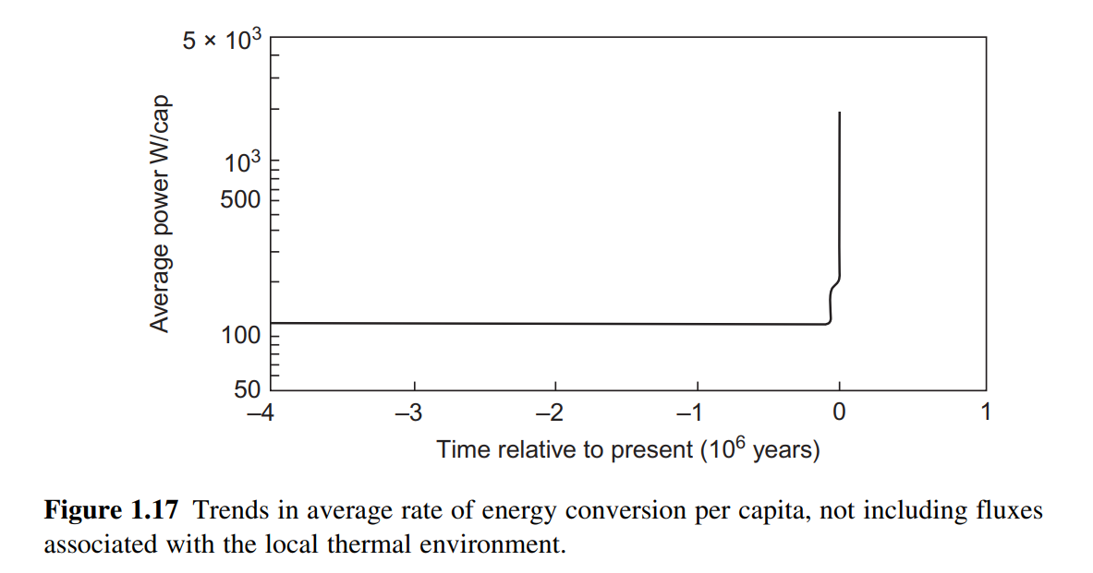
Visualizing Historical Trends in Energy Use
Figure 1.17 shows the trend in average rate of energy conversion per capita, on a linear time scale.
Figure 1.18 shows the same trend on a logarithmic time scale, extending backward from the year 2000.
Figure 1.19 shows trends in the distribution of the average rate of energy use on different types of energy resources.

Slide 26
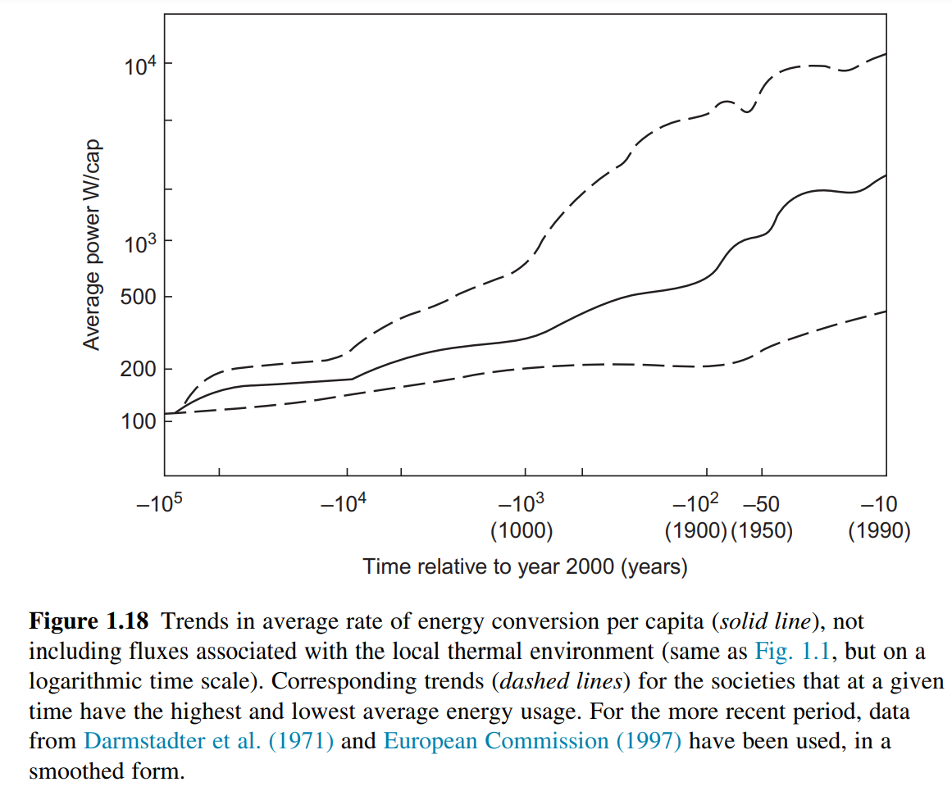

Slide 27
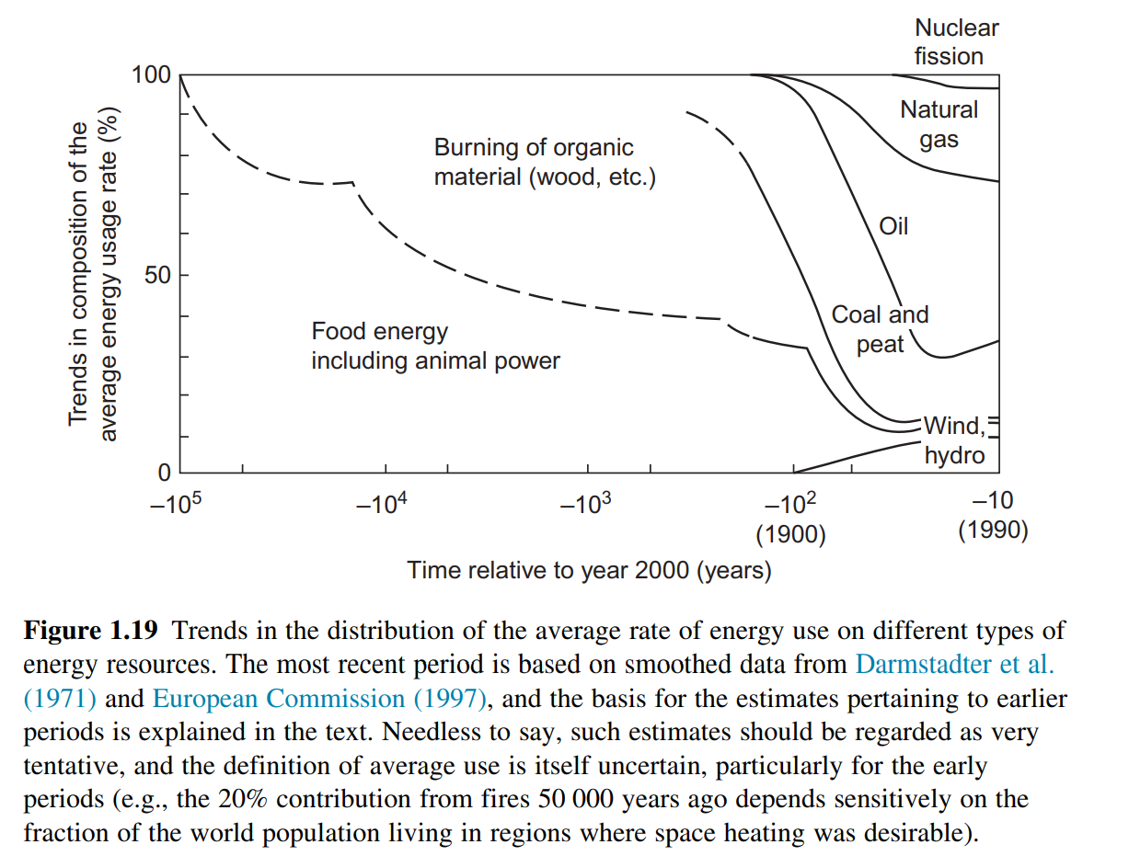

Slide 28
Resource Prospects and the Sustainability Imperative
Figure 1.18 shows the very large difference between the energy use of the affluent countries or affluent persons within countries and the energy use of the least energy-using inhabitants of poor countries.
Conventional economists argue that the inventiveness of man will lead to substitution of new materials for those threatened by exhaustion, in an ever-ongoing process.
Most geologists believe that oil and natural gas production will peak sometime within the next one or two decades.
Measures for improving energy efficiency are already available that will raise efficiency by a factor of 3-5 without any substantial increase in cost.
The hope entertained by some fusion researchers, that it may some day be possible to find materials for the confinement structure that do not present a radioactivity danger after exposure to the operating conditions for nuclear fusion, seems to be inconsistent with the physics of fusion.

Slide 29
Global Temperature Impacts and Other Climate Impacts
The greenhouse effect itself is a completely understood physical phenomenon, to which we owe the habitability of the Earth.
Human interference is altering both the magnitude of the greenhouse effect and a number of other things, and it is the climate change induced by this that should worry us.
The models’ accuracy is limited by two approximations: One is use of an integration mesh that is much more coarse than some known variations in atmospheric variables. The other approximation is that the climate variables used in models are averages of the true variables.
It is important to realize that the Earth atmosphere system is not in its most stable state. The present state is meta-stable, and a more stable situation could occur if snow and ice covered the entire Earth’s surface.
The bottom line is clearly “Don’t play with the climate”!

Slide 30
The Role of Environmental and Social Issues
The development in energy use is linked to another factor that may serve to accelerate the energy transition, namely, increased awareness of the negative environmental impacts of energy production and use.
Recently, man has reached a technological level enabling him to convert energy at rates that can be maintained over extended areas and that are no longer small compared to the energy fluxes of solar origin that are responsible for the climate.
Energy use and resource depletion do not, of course, constitute the primary goals of any society or any individual within a society. For example, the average European or Japanese uses about half as much energy as the average North American, but the former have a living standard no lower than that of the average North American.
In the recent century, energy habits have been formed largely by those who sell fossil energy and energy-using equipment. They are responsible for consumer behavior biased toward buying an additional kWh of energy instead of saving one by efficiency measures, even if they are cheaper. This is linked to the “growth paradigm” introduced by the simplistic market economy in the 18th century.

Slide 31
Solar radiation
Solar radiation reaches the Earth’s surface at a maximum flux density of about 1.0 kW/m² in a wavelength band between 0.3 and 2.5 μm, which includes the visible region from ~0.4 to 0.7 μm.
For inhabited areas, this flux varies from about 3 to 30 MJ/m²/day, depending on place, time, and weather. The spectral distribution is determined by the 6000 K surface temperature of the Sun, so it is an energy flux of very high thermodynamic quality.

Slide 32
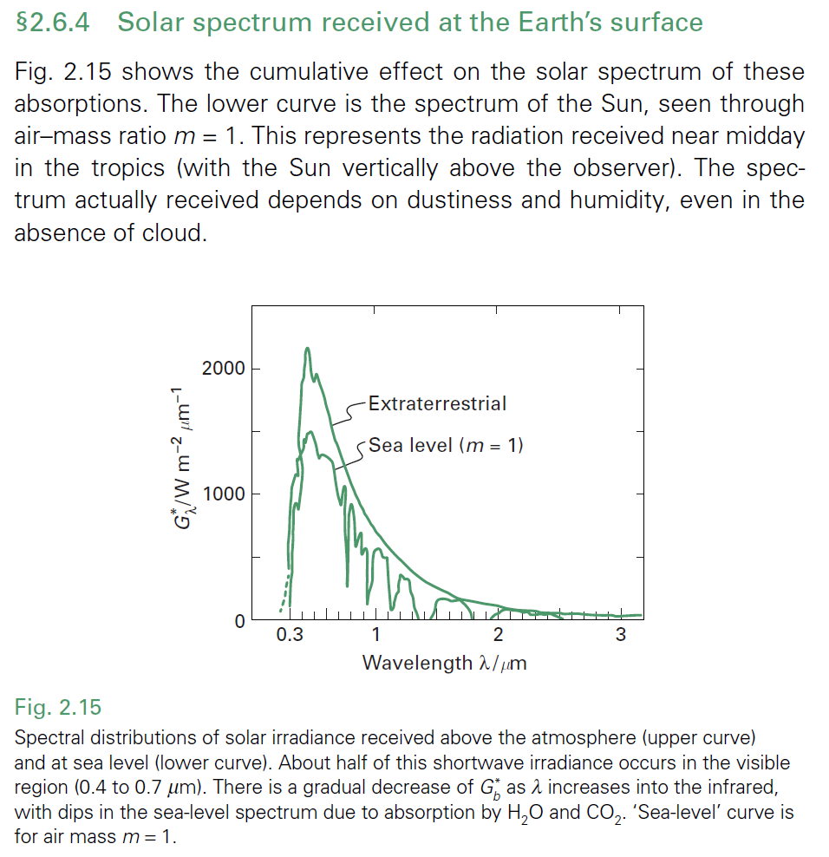
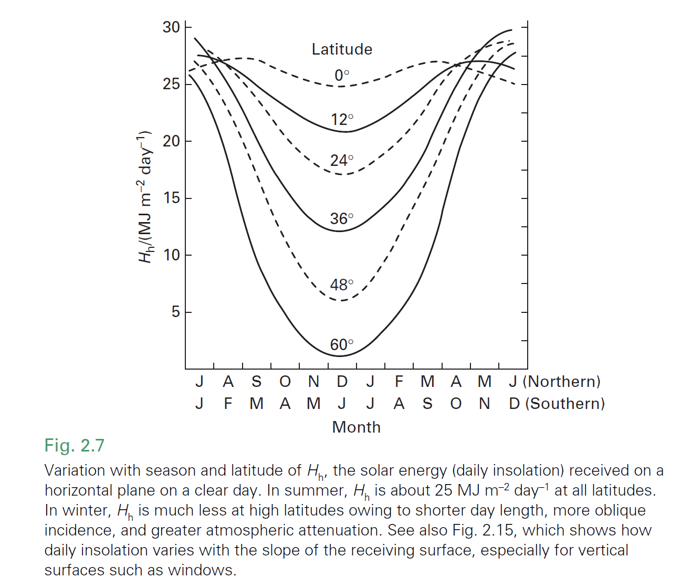
Source: Twidell (2022)

Slide 33
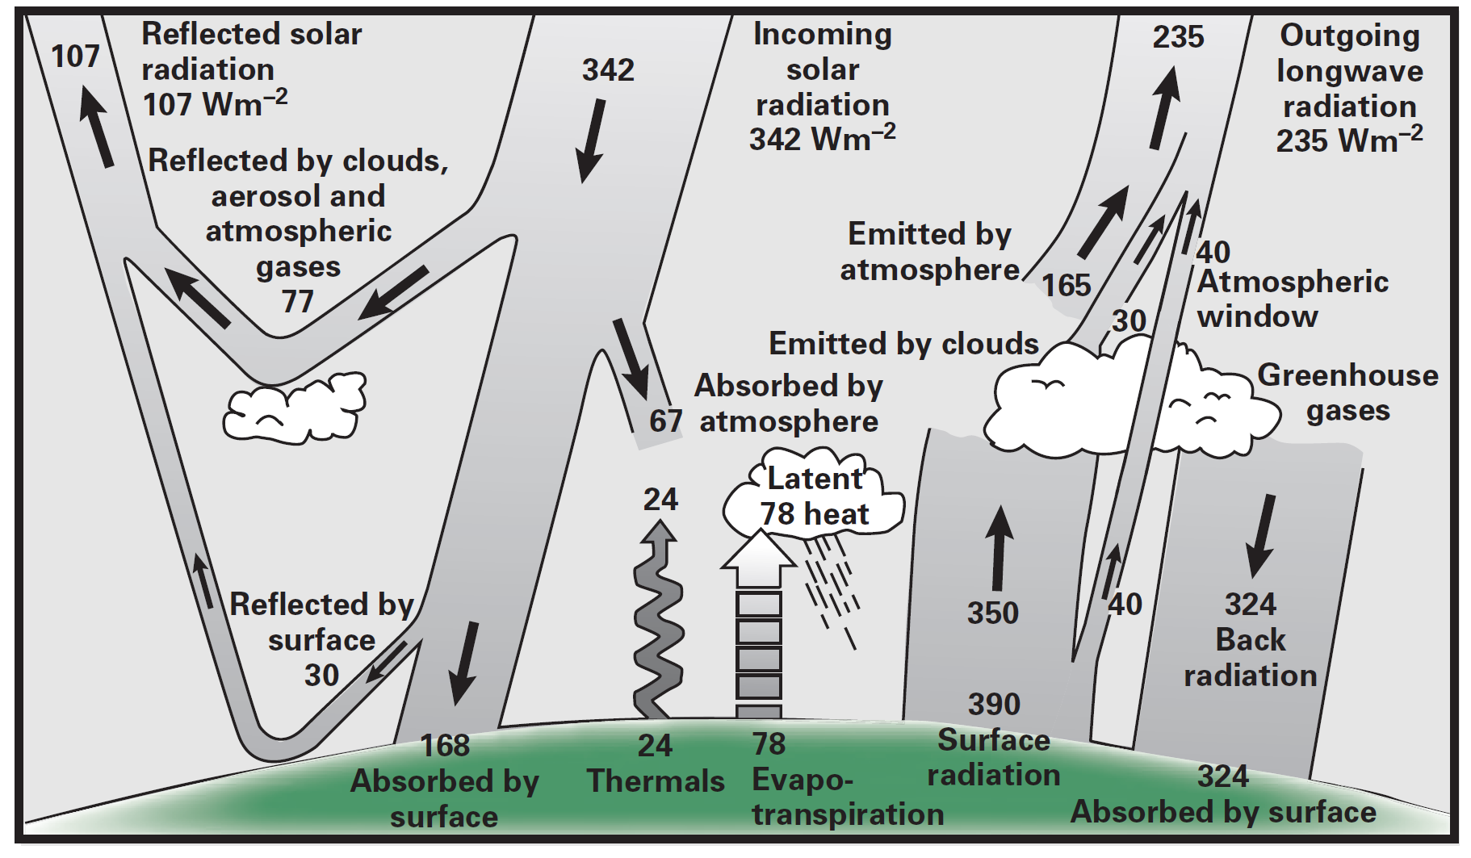
Source: Twidell (2022)

Slide 34
Solar radiation summary
Geometric formulae accurately calculate the effect of inclination on beam irradiation (i.e. direct from the Sun), but estimating diffuse radiation (the component scattered by clouds, etc.) is uncertain.
The Earth emits longwave radiation (~10 μm) to maintain thermal balance with the incoming solar shortwave irradiation.
‘Greenhouse’ gases in the atmosphere absorb much of this longwave radiation, thereby keeping the Earth warmer than it would otherwise be.
Human (anthropogenic) activity (especially burning fossil fuels) has increased the amount of such gases in the atmosphere, thereby measurably raising the average temperature of the Earth’s surface. This is one symptom of more general climate change.

Slide 35
Solar water heating
Importance: Heating fluids (air and water) is a significant energy demand in domestic, commercial, industrial, and agricultural sectors (e.g., 30% of UK energy use in buildings).
Basic Principle: Solar energy can be directly used for heating fluids.
Passive vs. Active Systems:
Passive: Solar energy absorbed and utilized without significant mechanical input (e.g., no pumps).
Active: Fluid heated in a collector and moved by pumps or fans for use or storage.
Focus of Chapter: Non-concentrating collectors (flat-plate and evacuated) for heating fluids below 80°C, due to their efficiency, ease of operation, and cost-effectiveness.
Global Relevance: Solar water heating is an established industry with millions of households using it worldwide, especially in China, Australia, Germany, and other countries.

Slide 36
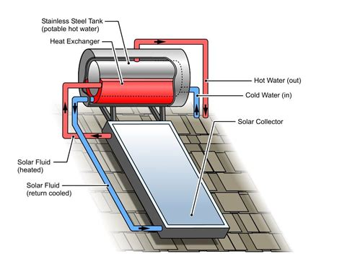
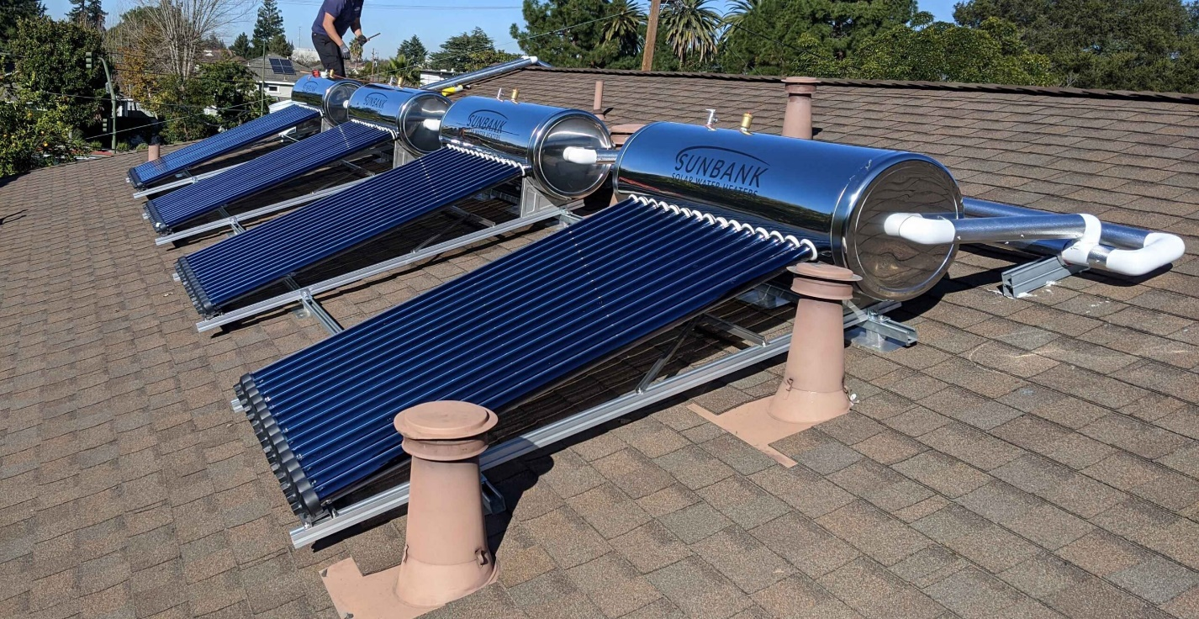
wardowtuocircuit.z21.web.core.windows.net
https://thesunbank.com/products/sunbank-40-gallon-solar-water-heater/

Slide 37
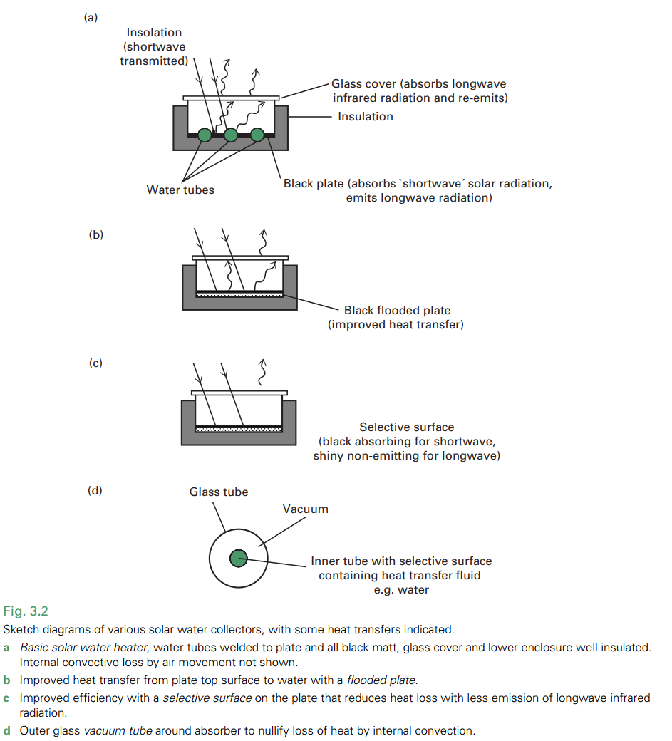
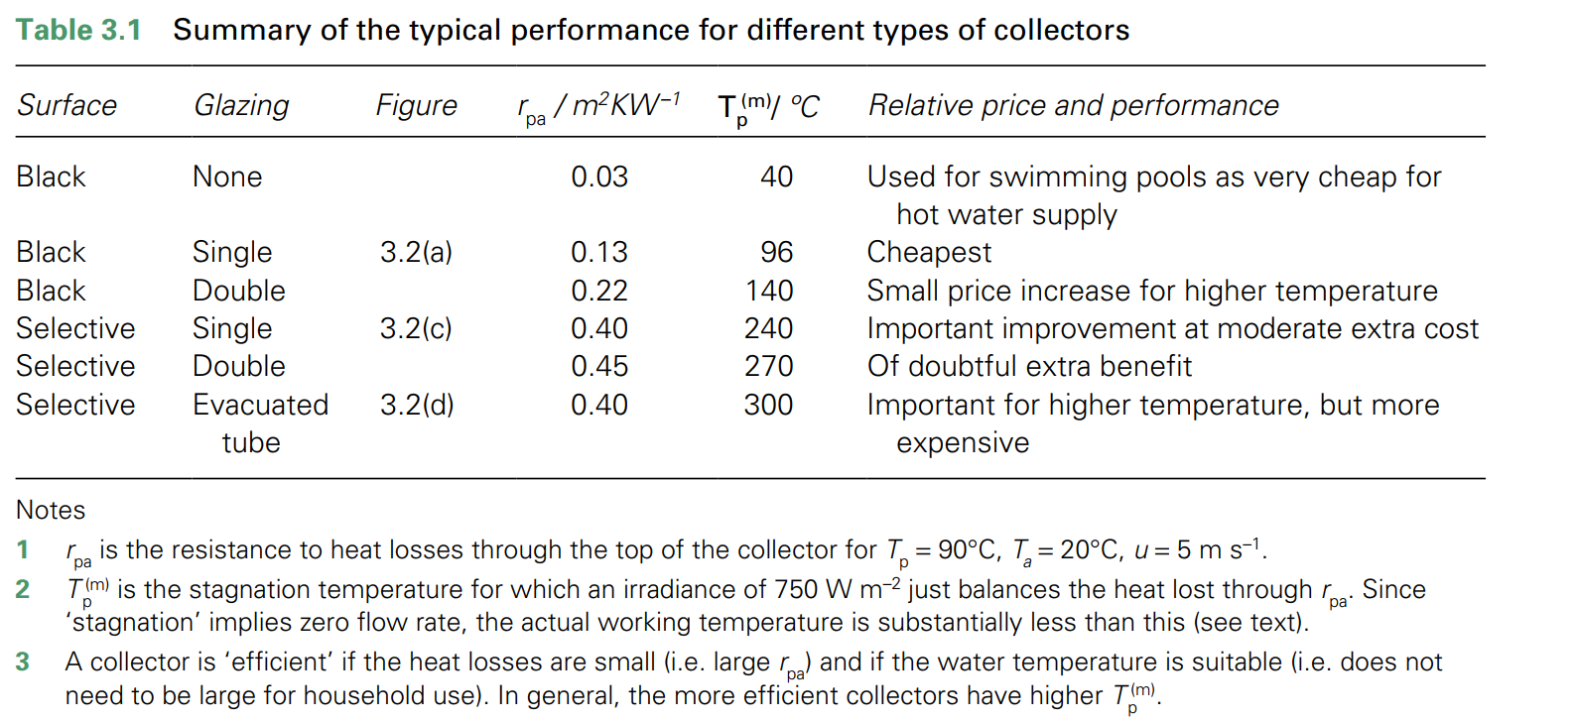
Source: Twidell, John. (2022)

Slide 38
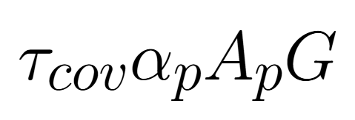
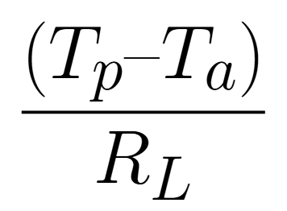
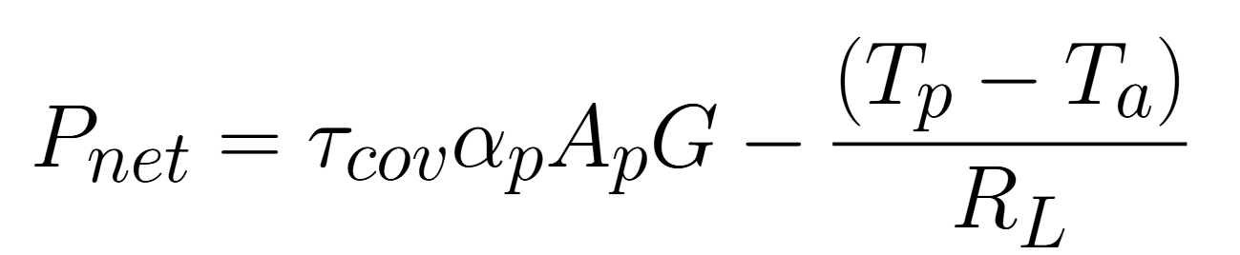
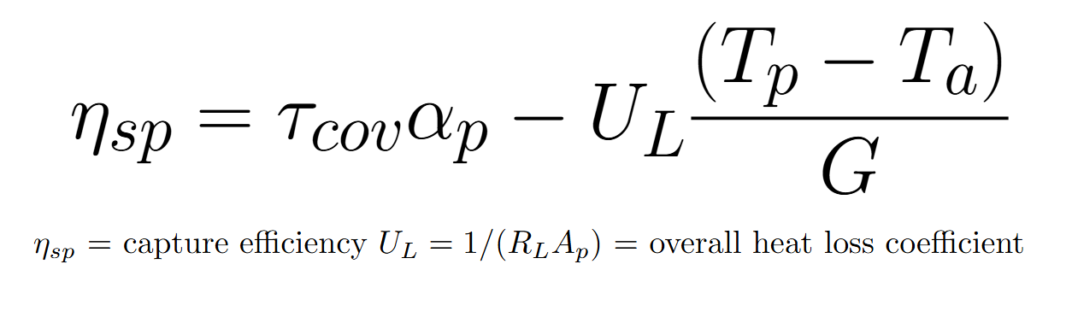
Flat-Plate Collectors: Heat Balance and Performance Estimation
Collector Components: Absorbing plate, tubes for fluid, transparent cover (optional), insulation.
Heat Circuit Theory: Analysis based on "heat circuit theory," analogous to electrical circuits, using thermal resistances.
Heat Input: Radiant flux striking the plate:
Heat Loss: Rate of heat loss from plate to environment:
τcov​ = transmittance of cover
αp​ = absorptance of plate
Ap​ = plate area
G = irradiance
Tp​ = plate temperature
Ta​ = ambient temperature
RL​ = thermal resistance to heat loss
Capture Efficiency:

Slide 39
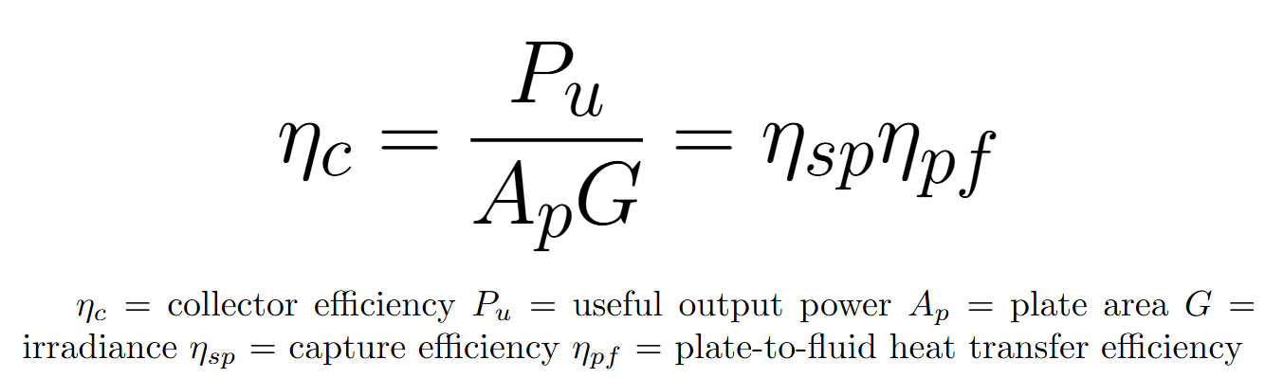
Flat-Plate Collector Efficiency and Key Design Features
Collector Efficiency
Factors Affecting Efficiency: Collector efficiency decreases as plate temperature increases due to higher heat losses.
Stagnation Temperature ($T_{p(m)}$): Maximum temperature when fluid flow is zero, useful for characterizing collector performance.
Efficiency Curve is typically used to represent collector performance (Figure 3.6).
Key Design Feature - Insulation: Rear insulation is crucial and cost-effective to minimize heat loss.
Key Design Feature 2 - Pressure and Safety: Safety measures are essential to prevent hazards from hot water and boiling (pressure release valves, etc.).

Slide 40
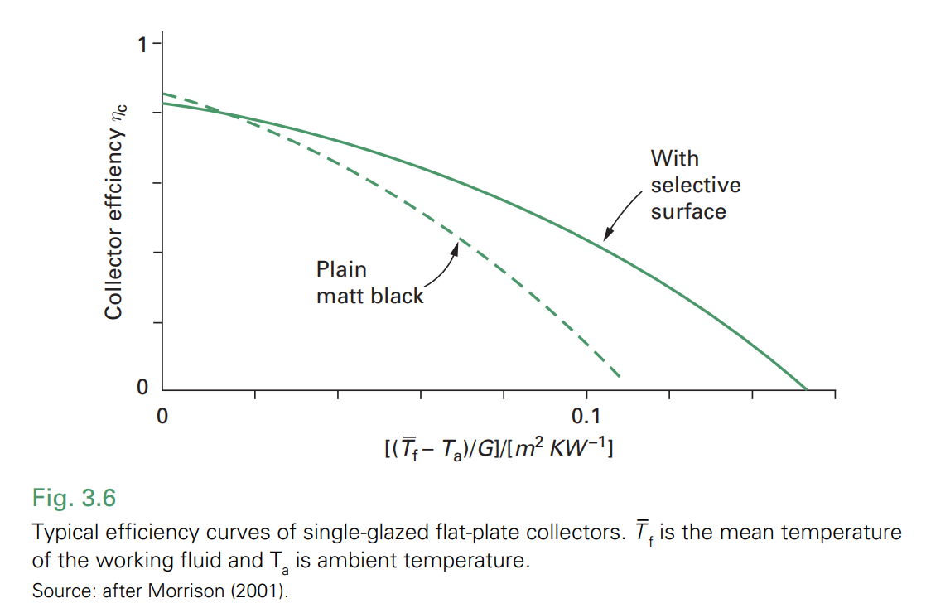

Slide 41
Systems with Separate Storage: Active and Thermosyphon
Separate Storage: Collectors typically connected to a separate insulated storage tank (100-300 liters for domestic use).
Active Systems (Forced Circulation):
Pump needed when the tank is below the collector (common in freezing climates and integrated systems).
Antifreeze fluids can be used in the collector circuit.
Small pumps circulate water, causing a small temperature increase per pass (5-10°C).
Controlled pumps (or fixed-speed) are used, often with automatic on/off switches based on temperature difference to optimize performance and prevent nighttime heat loss.
Thermosyphon Systems (Passive Circulation):
Storage tank placed above the collector.
Circulation driven by natural convection due to density differences between hot and cold water.
Simpler, no pump needed, preferred in sunny climates, and avoids boiling risks.

Slide 42
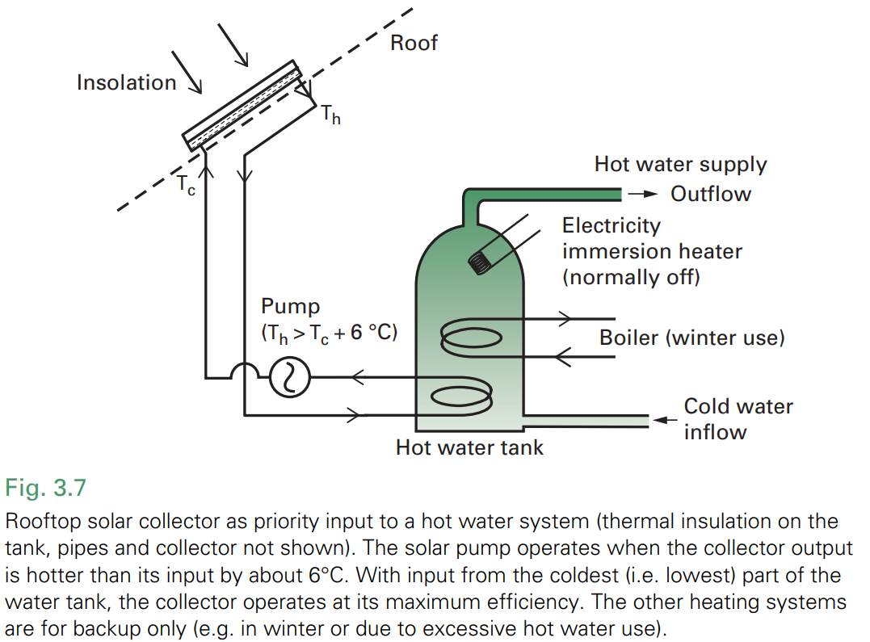
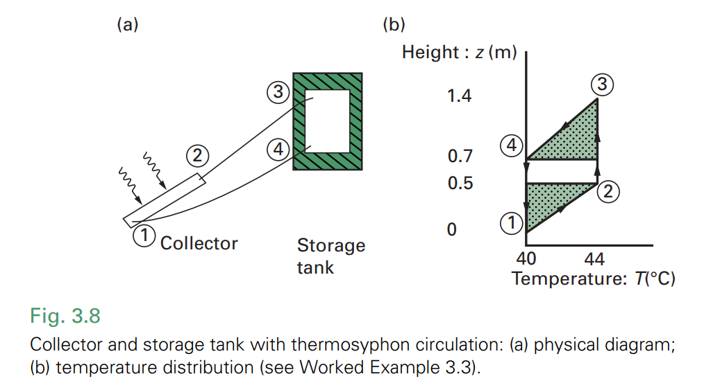

Slide 43
Advanced Collectors: Selective Surfaces and Evacuated Designs
Selective Surfaces:
Improve efficiency by reducing radiative heat loss.
Principle: Surfaces that are highly absorptive for shortwave solar radiation (high α) but have low emissivity for longwave infrared radiation (low ε).
Ideal Selective Surface: α = 1 for solar spectrum, ε = 0 for thermal infrared.
Practical Surfaces: Metal-semiconductor composites.
Manufacturing: Mention techniques for creating selective surfaces.
Evacuated Collectors:
Further reduce heat loss by minimizing convection.
Design: Vacuum between absorber and glass cover eliminates convective heat losses.
Types: Evacuated tube collectors are common.
Performance: Higher stagnation temperatures and improved efficiency, especially at higher operating temperatures, but more expensive.

Slide 44
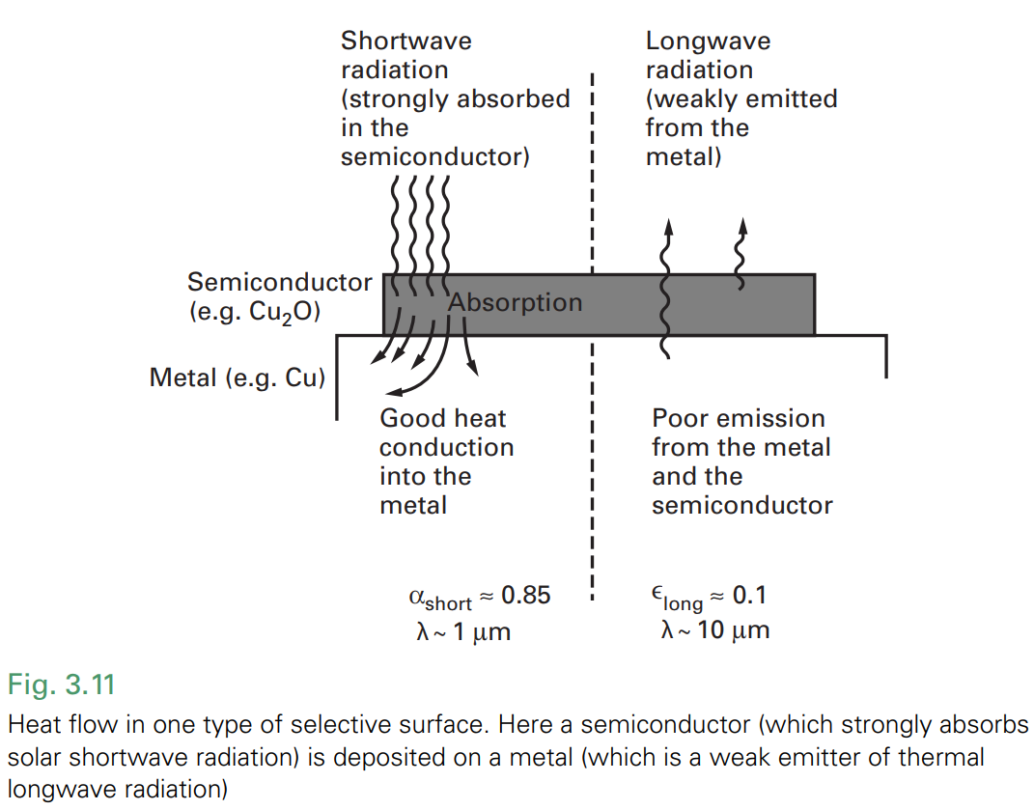
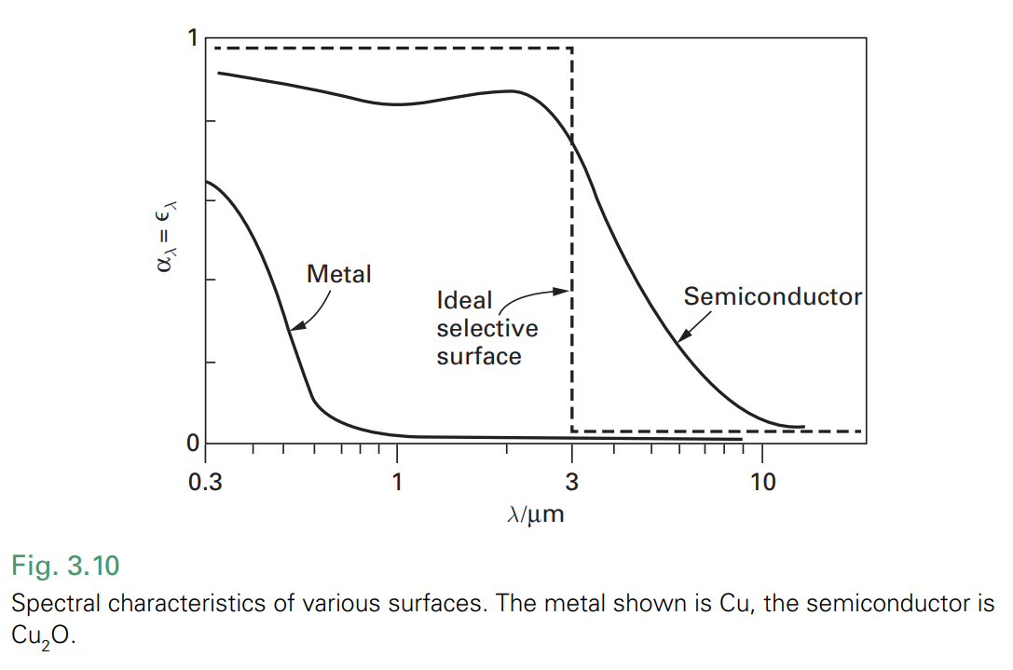

Slide 45
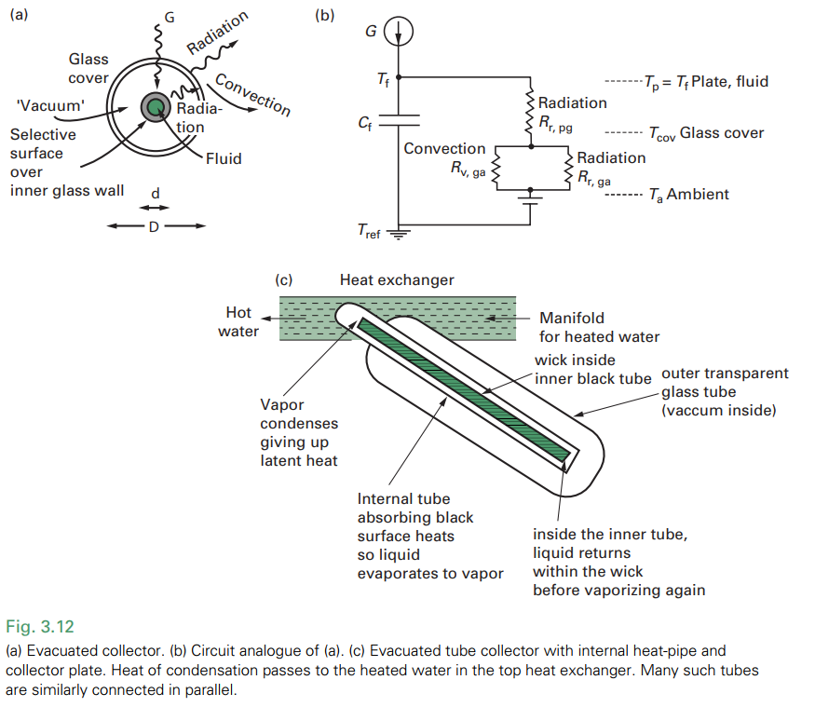

Slide 46
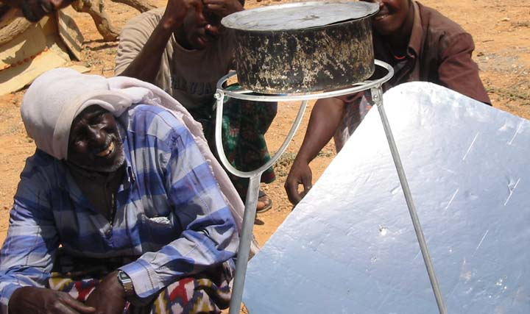
Other Solar Thermal Applications: Expanding Beyond Water Heating
Key Applications Covered:
Air Heaters & Crop Drying
Solar Refrigeration & Cooling
Water Desalination
Solar Salt-Gradient Ponds
Solar Concentrators
Concentrated Solar Thermal Power (CSTP)
Fuel & Chemical Synthesis
http://solarcooking.org/Bender-Bayla-Somalia.htm

Slide 47
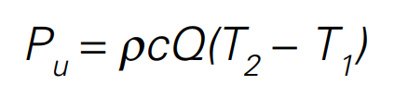
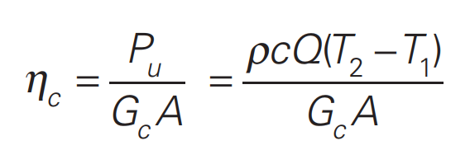
Solar Air Heaters and Crop Drying
Solar Air Heaters: Similar to water heaters but use air as the fluid. Cheaper due to lighter materials and no frost protection needed.
Applications: Building heating, crop drying.
Pu​ = Useful heat flow into the air
ρ = Density of air
c = Specific heat capacity of air
Q = Volumetric flow rate of air
T1​ = Inlet temperature
T2​ = Outlet temperature
Heat Flow Equation:
Collector Efficiency Equation:
A​ = Collector area
Gc = Solar irradiance incident on collector
Crop drying prevents fungal attack and spoilage in grains and agricultural products. Requires heat and water vapor transfer.

Slide 48
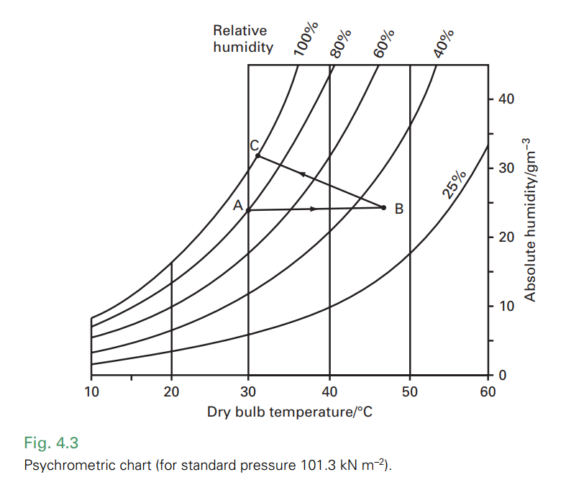
Air at point A (30°C, 80% relative humidity and 25 g/m³ absolute humidity) is heated to point B at about 47°C. Here the relative humidity has decreased to about 35% (absolute humidity, i.e. the mass of water content. remains the same). The air is then used to dry a crop, so the relative humidity rises to 100% as it cools back to 30°C, now with increased water content represented by the increased absolute humidity of about 30 g/m³.

Slide 49
Solar Thermal Refrigeration, Cooling, and Water Desalination
Solar Refrigeration/Cooling:
Absorption Refrigeration: Uses heat to drive a cooling cycle (e.g., ammonia-water system).
Components: Absorber, generator, condenser, evaporator, throttling valve.
COP (Coefficient of Performance): Lower COP than electric refrigerators but valuable where electricity is limited or low-cost heat is available.
Solar Desiccant Cooling: Uses desiccants to dehumidify air, followed by evaporative cooling.
Water Desalination (Solar Stills):
Solar Distillation: Uses solar heat to evaporate water, leaving salts behind. Vapor condenses to produce fresh water.
Simple Solar Still: Basin with saline water, transparent cover for condensation.
Output: ~8.3 kg/day per m² of insolation (ideal conditions).
Economics: PV-driven reverse osmosis often more cost-effective for large scale.

Slide 50
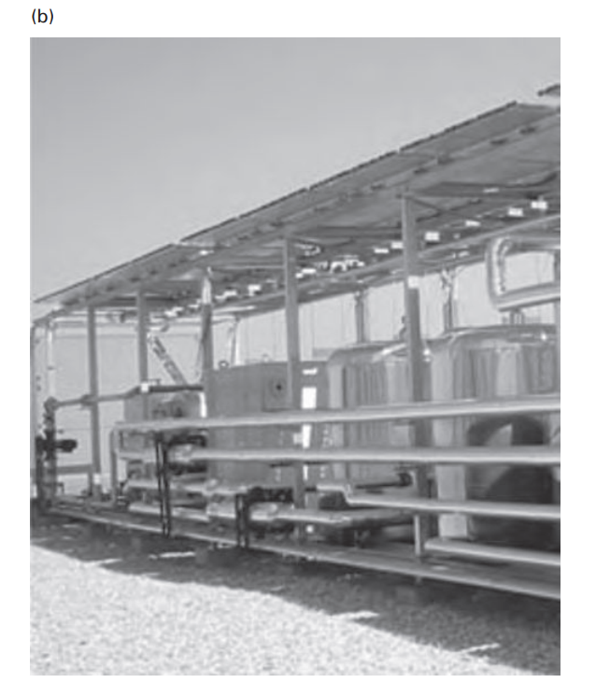
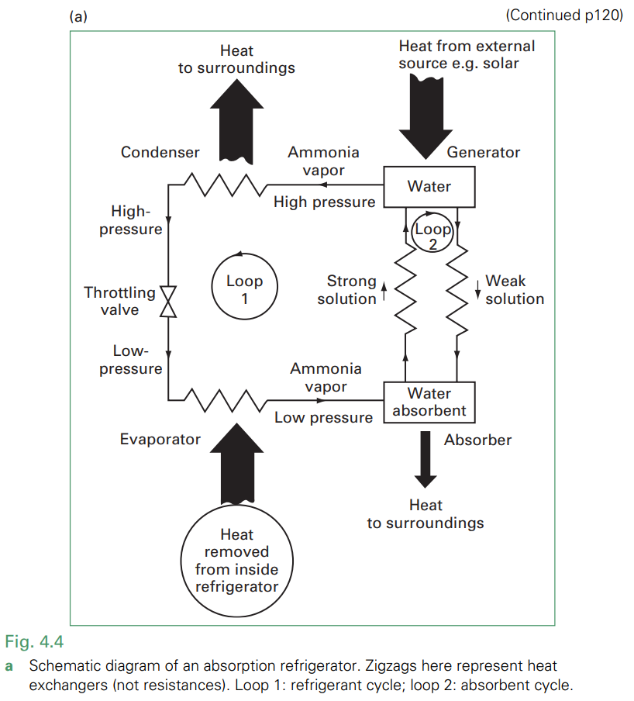
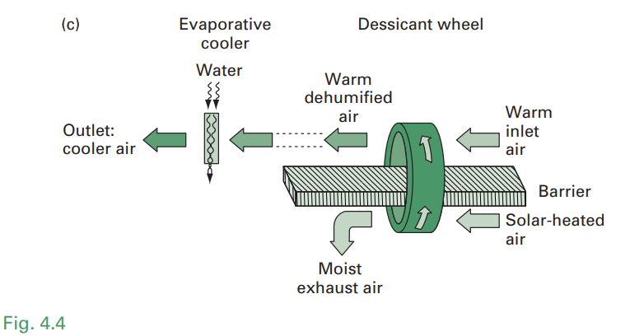
a Schematic diagram of an absorption refrigerator. Zigzags here represent heat exchangers (not resistances). Loop 1:refrigerant cycle; loop 2: absorbent cycle.
b Solar absorption cooling system installed in 2004 on the roof of an office building in Madrid, Spain. Heat for the ‘generator’ comes from the solar evacuated tube collectors at the top of the photo. Visible (left to right in the photo) are the ‘cooling tower’, the 105 kW chiller unit, and buffer tanks of cold and hot water respectively. The system includes a total of 72 m2 of collectors (not all shown here), and achieves a room temperature of 19°C even in ambient temperatures ~40°C.
c Solar desiccant cooling. The desiccant on the wheel picks up moisture from the inlet air (above the barrier) and loses moisture (below the barrier) to the stream of solar-heated air.

Slide 51
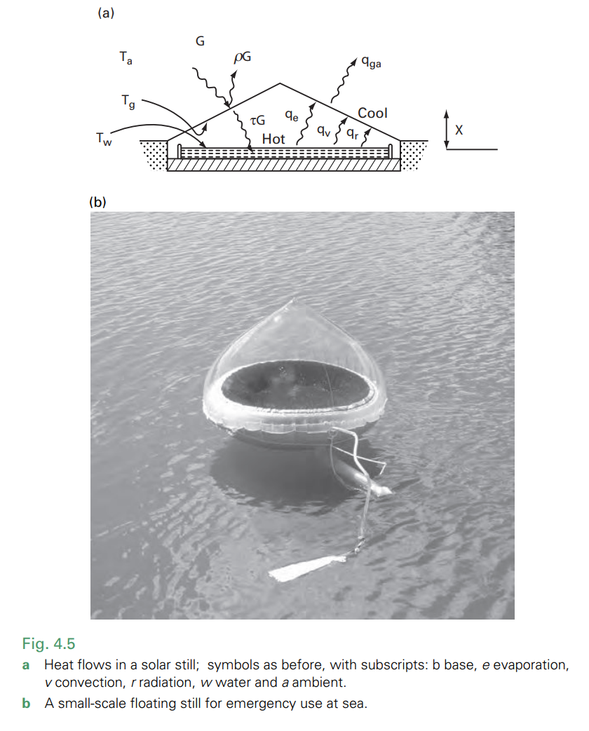

Slide 52
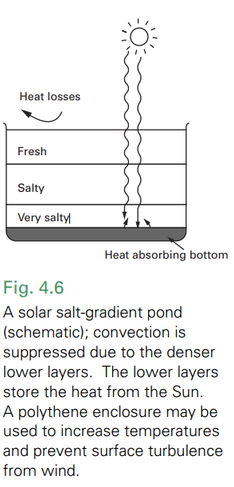
Solar Salt-Gradient Ponds and Solar Concentrators
Solar Salt-Gradient Ponds:
Large-Scale Low-Temperature Heat Source: Uses salt gradient to suppress convection and trap heat in lower layers.
Construction: Large area (hectare), ~2m deep, layered salt concentrations (densest at bottom), black liner.
Heat Storage: Interseasonal heat storage possible due to large thermal capacitance.
Applications: Building heating, industrial process heat, low-temperature electricity generation.
Examples: Beit Ha’Harava (Israel), El Paso (Texas) - Demonstrated feasibility but limited commercial use due to complexity and long time constants.

Slide 53
Solar Concentrators:
Need for Higher Temperatures: Many applications (electricity generation, material processing, fuel synthesis) require temperatures higher than flat-plate collectors can achieve.
Concentration Principle: Focusing solar radiation from a large area onto a smaller receiver to increase energy flux and temperature.
Types: Linear concentrators (~100x concentration, ~750°C), Point concentrators (~3000x concentration, ~3500°C).
Applications: Heat engines for electricity, chemical/fuel synthesis, high-temperature material processing.
Linear Concentrators:
Parabolic Trough: Line focus, cylindrical parabolic reflectors.
Temperature: Up to ~750°C.
Point Concentrators:
Parabolic Dish: Point focus, 3D parabolic reflectors.
Temperature: Up to ~3500°C.
Fresnel Concentrators (Figure 4.9):
Fresnel Lenses & Mirrors: Approximates curved surfaces with segmented flat surfaces. Lighter and cheaper than parabolic reflectors.
Linear Fresnel Reflectors: Array of long, narrow mirrors focusing onto a linear receiver.
Non-Imaging Concentrators:
Purpose: Maximize radiation capture without precise focusing, useful for lower concentration ratios.

Slide 54
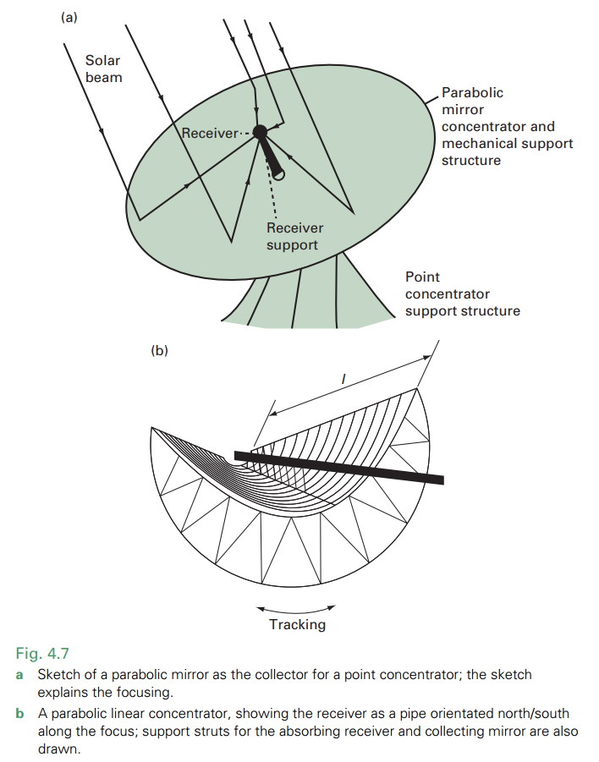
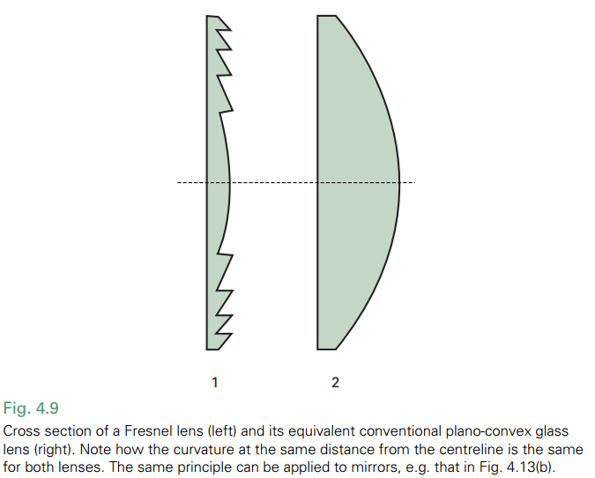

Slide 55
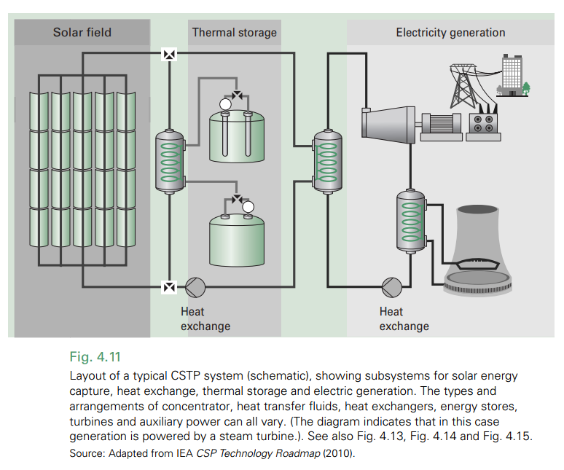
Concentrated Solar Thermal Power (CSTP) and Emerging Applications
Concentrated Solar Thermal Power (CSTP):
Electricity Generation: Uses concentrated solar heat to drive heat engines (e.g., steam turbines) and generate electricity.
CSTP System Types:
Parabolic Trough Systems: Most mature technology.
Solar Tower Systems (Central Receiver): Heliostats reflect sunlight to a central receiver on a tower. Higher temperatures possible.
Linear Fresnel Reflector Systems: Lower cost, suitable for medium temperatures.
Parabolic Dish Systems: High efficiency, modular, good for distributed generation.

Slide 56
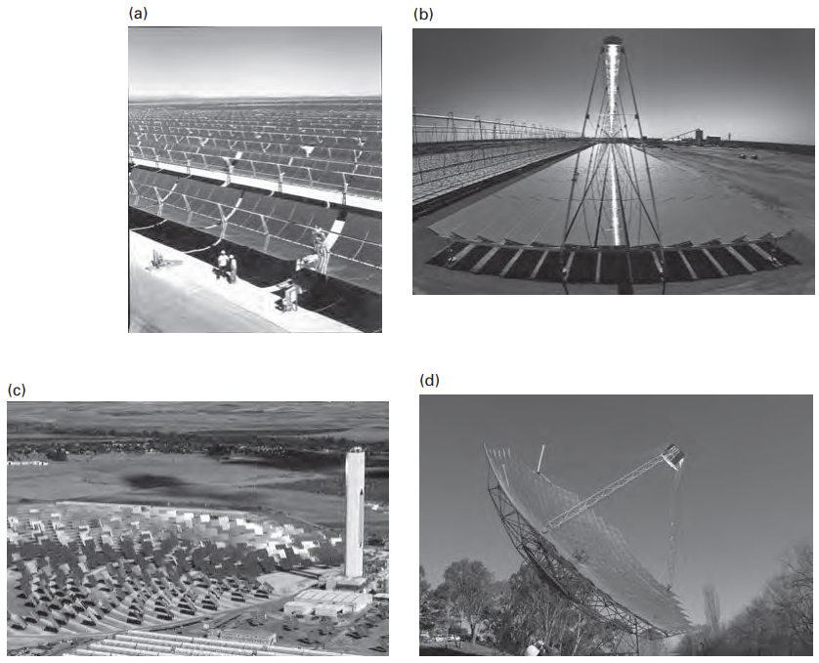
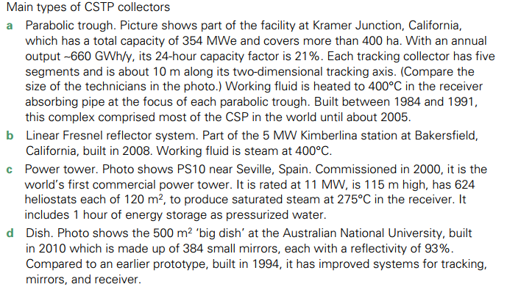

Slide 57
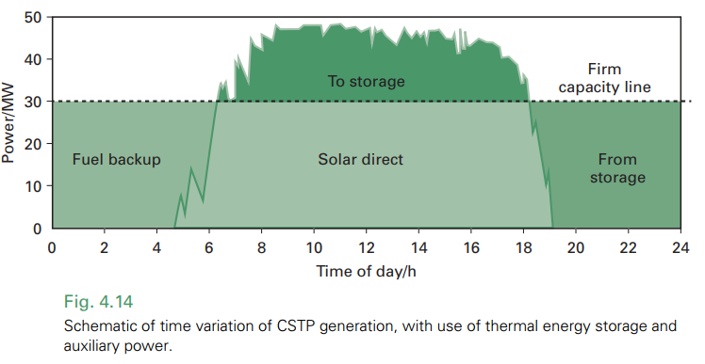
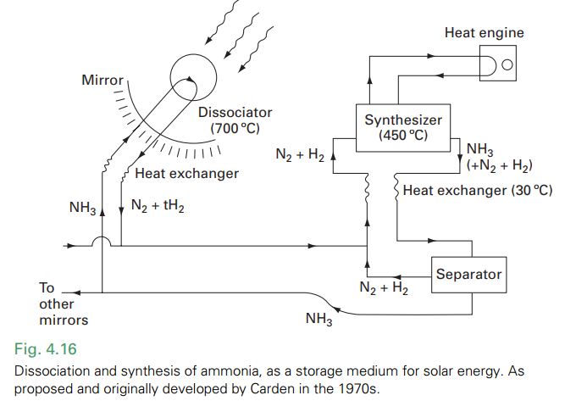
Other CSTP types:
Thermal Energy Storage (TES) (Figure 4.14): Crucial for dispatchability and matching solar supply to electricity demand. Molten salts are common storage media.
Thermochemical Storage (Figure 4.16): Closed-loop systems using reversible chemical reactions (e.g., ammonia dissociation/synthesis) for potentially higher energy density storage.
Small-Scale CSTP Microgeneration: Emerging for decentralized power.
Fuel and Chemical Synthesis:
Hydrogen Production (Solar Thermochemical Hydrogen): Using concentrated solar heat for high-temperature thermochemical reactions to produce hydrogen.

Slide 58
Photovoltaic (PV) Power Technology
Two Methods of Electricity Generation:
Electromagnetic Dynamic Generation (Conventional): Moving magnetic field and conductor (turbines, engines).
Photovoltaic Generation (PV): No moving parts, electricity from light absorption in semiconductors.
PV Effect Discovery: Becquerel (1839), first practical PV cell by Chapin, Fuller, and Pearson at Bell Labs (1954) using silicon.
Rapid Growth of PV: Exponential increase in installed capacity, from ~200 MW (1990) to > 80 GW (2012) and continuing.
Driving Factors:
Universal Applicability: Sunlight available globally.
Modularity: Scalable from watts to megawatts.
Reliability & Longevity: Long lifespan, low maintenance.
Ease of Use & Clean Energy: Quiet, emission-free operation.
Applications: Stand-alone systems (early focus) and grid-connected systems (dominant now).
Cost Reduction: Ex-factory cost decreased significantly, becoming competitive with conventional electricity sources.

Slide 59
The photovoltaic effect:
The process where light energy is converted directly into electrical energy in certain materials, typically semiconductors. When photons of light strike a photovoltaic material, they can excite electrons, boosting them to a higher energy level and creating electron-hole pairs. In a specially designed structure, like a solar cell with a p-n junction, these separated charges are directed by an internal electric field to flow in a specific direction, generating a voltage and an electric current. This current can then be harnessed to power external circuits, effectively transforming light into electricity.

Slide 60
The p-n junction:
is formed at the interface between two types of semiconductor material: p-type and n-type. In n-type material, the semiconductor is doped to have an excess of free electrons (negative charge carriers), while in p-type material, it's doped to have an excess of holes (positive charge carriers, essentially places where electrons are missing). When these two materials are joined, electrons from the n-side diffuse across the junction to the p-side, and holes from the p-side diffuse to the n-side. This diffusion creates a region near the junction called the depletion region, which is depleted of free charge carriers. Crucially, this process also establishes an electric field across the depletion region, pointing from the n-side to the p-side. This built-in electric field is what's essential for the photovoltaic effect, as it acts to separate and direct the light-generated charge carriers in a solar cell, creating an electric current.
https://www.visualcapitalist.com/animation-how-solar-panels-work/

Slide 61


Slide 65
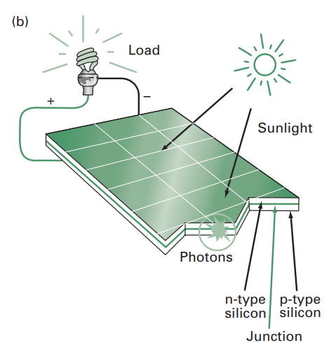
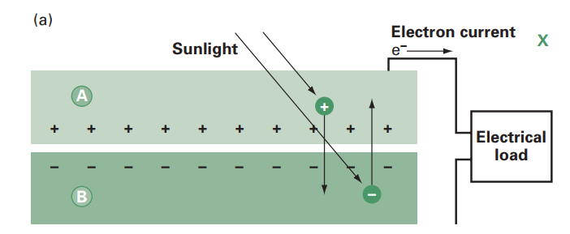
Photovoltaic Basics and Circuit Properties
Basic Principle: Photons separate charge carriers in semiconductor material, creating current if an electric field is present.
Built-in Electric Field: p-n junctions in PV cells create a permanent electric field.
Voltage and Current: ~0.5 V potential difference and ~400 A/m² current density under 1 kW/m² solar radiation.
Efficiency: Commercial cells: 12-25% (sunshine), ~50% (concentrated sunlight).
Modules: Interconnected cells in weatherproof encapsulation, typically 15-30V open-circuit voltage.
Direct Current (DC): PV cells produce DC electricity, inverters needed for AC conversion.

Slide 66
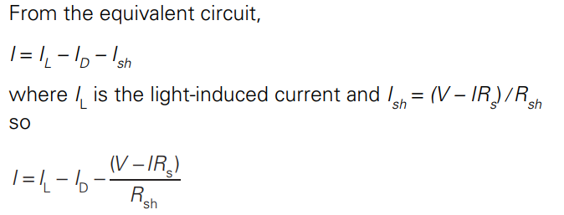
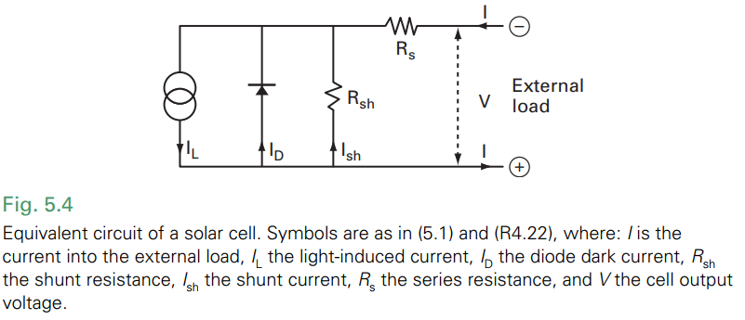
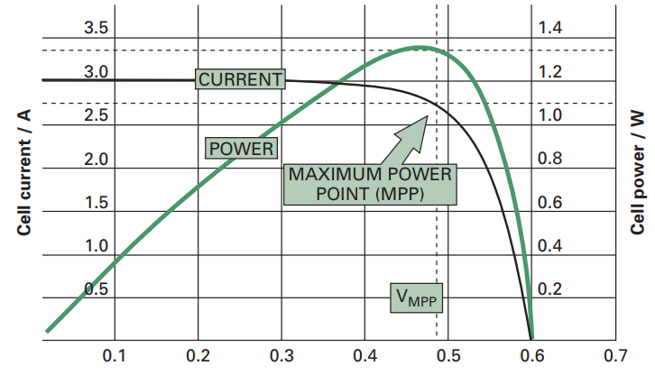
Equivalent Circuit:
I-V Characteristic: Shows short-circuit current (Isc​), open-circuit voltage (Voc​), and peak power line.
Maximum Power Point (MPP): Optimal operating point for maximum power output. Load matching is crucial and done by MPPT controllers.
Temperature Effects: Increased temperature reduces Voc​ and power output.

Slide 67
Photovoltaic Applications and System Configurations
Two Main Application Types:
Stand-Alone Systems: Independent power for remote locations, specific devices.
Grid-Connected Systems: Integrated with utility grids, contributing to mainstream power supply.
Stand-Alone Applications:
Early applications: Space satellites, remote telecom, etc.
Current uses: Rural electrification, lighting, water pumping, medical refrigerators, signage, portable devices.
Advantages: Reliability, low maintenance, no fuel needed. Ideal for remote areas.
Grid-Connected Systems:
Microgeneration: Building-integrated PV (rooftop), excess power fed to grid.
Solar Farms: Large arrays connected directly to distribution grids.
Inverters: Convert DC to grid-compatible AC power, synchronize with grid frequency, and include safety features.

Slide 68
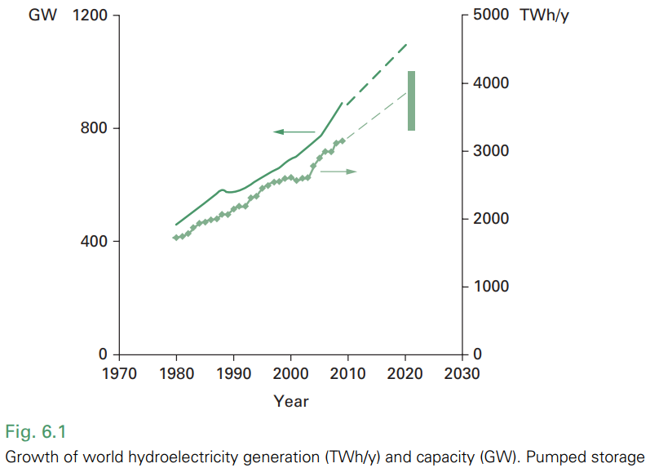


Hydropower: A Thermodynamic Approach to Water Power
Definition: Hydropower utilizes the energy of falling water to generate power, primarily electricity (hydroelectricity).
Established Renewable Energy: Long-standing and widely used renewable energy source with significant global capacity.
Energy Conversion Chain:
Potential Energy: Water at height possesses gravitational potential energy.
Kinetic Energy: As water falls, potential energy is converted to kinetic energy.
Mechanical Energy: Kinetic energy of water drives turbines, converting it to mechanical energy (rotational).
Electrical Energy: Turbines drive generators, converting mechanical energy into electrical energy.
Fundamental Equation (Potential Power):
High Conversion Efficiency: Hydropower systems boast high conversion efficiencies (up to 90%), minimizing energy losses in the transformation process from water potential energy to electricity.

Slide 69
Hydropower System Thermodynamics: Efficiency, Resource Assessment, and Considerations
System Efficiency Considerations
Turbine Efficiency: While turbines can reach ~90% efficiency, overall system efficiency is lower due to losses in:
Head Loss: Friction in penstocks/pipes; Generator Efficiency: Electrical conversion losses; Transmission Losses: Energy dissipated during electricity transmission.
Factors Affecting Efficiency: Head, flow rate variations, turbine design, operational conditions, and maintenance all influence thermodynamic performance.
Resource Assessment - Thermodynamic Parameters:
Head (H) Measurement (Surveying techniques to determine vertical drop). Distinction between total head (Ht​) and available head (Ha​) after friction losses (Hf​).
Flow Rate (Q) Measurement (Importance of accurate flow measurement, especially minimum flow )
Environmental and Social aspects:
Sustainable Energy Source: Hydropower is a renewable and generally low-carbon energy source, contributing to thermodynamic sustainability.
Environmental Impacts: Reservoir creation alters ecosystems, affects fish migration, potential methane emissions from reservoirs (decomposition).
Social Impacts: Displacement of communities, alteration of riverine landscapes.

Slide 70
Introduction to Wind Resource and Global Wind Patterns
Wind as Solar Energy Conversion: Wind energy originates from solar radiation, driving atmospheric convection and pressure differences.
Global Wind Patterns:
Uneven Solar Heating: Equatorial regions receive more solar energy, heating air.
Convection: Heated air expands, becomes less dense, and rises, creating pressure gradients.
Global Circulation Cells: Atmospheric circulation patterns (Hadley, Ferrel, Polar cells) driven by thermal gradients and Earth's rotation.
Trade Winds & Westerlies: Resulting large-scale wind systems with characteristic directions and speeds.

Slide 71


Slide 72

Global Wind Speed Distribution:
Strongest Winds: Prevail over oceans in mid-latitudes ("roaring forties") due to fewer land obstructions.
Seasonal Variation: Wind patterns shift with seasons due to Earth's declination and changing solar heating.
Favorable Regions: Northwestern USA, Europe, New Zealand, Chile identified as high wind resource areas.
Kinetic Energy of Wind: Vast kinetic energy reservoir in global winds, continuously replenished by solar input.

Slide 73



Characteristics of Wind: Speed, Shear, and Turbulence
Wind Speed Variation with Height (Figure 7.6):
Wind Shear: Wind speed increases with height above ground due to surface friction.
Boundary Layer: Planetary boundary layer (250-500m) characterized by turbulence and wind shear.
Highlights the non-uniform wind flow across a turbine rotor, impacting energy capture.
Turbulence:
Random Fluctuations: Wind speed and direction fluctuate rapidly and randomly due to atmospheric turbulence.
Planetary Boundary Layer: Turbulence is pronounced within this layer, affecting turbine design and performance.
Frequency Spectrum: Energy distribution across different frequencies of wind speed fluctuations.
uz​ = Wind speed at height z
us​ = Wind speed at reference height zs​ (typically 10m)
b′ = Wind shear exponent (typically ~1/7 in open areas)

Slide 74



Statistical Description of Wind: Probability and Power
Wind Speed Probability Distribution:
Frequency Distribution: Wind speeds are not constant; described by probability distributions.
Weibull and Rayleigh Distributions: Common statistical models to represent wind speed probabilities (Weibull more general, Rayleigh a special case).
Wind Rose:
Directional Wind Data: Visual representation of wind direction frequency and speed.
Site Characterization: Essential for turbine siting, considering prevailing wind directions and potential obstacles.
Wind Power Distribution (Figure 7.9 & 7.10):
Power Proportional to u³: Power in the wind is highly sensitive to wind speed.

Slide 75

Wind Resource Assessment and Prediction: Practical Thermodynamics
Wind Resource Assessment:
Data Collection: Meteorological data, site-specific measurements (anemometers, wind vanes).
Wind Atlases & Software (e.g., WAsP): Tools for regional and local wind resource mapping and analysis.
Wind Measurement Instruments:
Anemometers: Measure wind speed (cup, propeller, sonic anemometers).
Wind Vanes: Measure wind direction.
Instrument Towers: Used to measure wind speed at various heights.
Wind Power Prediction:
Short-term Prediction: Forecasting wind for grid management and power dispatch.
Long-term Prediction: Essential for turbine design, site selection, and economic feasibility; relies on statistical analysis and historical data.
Thermodynamic Significance: Accurate wind resource assessment and prediction are crucial for:
Optimizing Energy Capture: Selecting appropriate turbine types and locations.
Economic Viability: Estimating energy yield and project profitability.
Grid Integration: Managing the variability of wind power in the electrical grid.

Slide 76

The Actuator Disk Model: A Thermodynamic Limit to Wind Energy Conversion
Idealized Model: The Lanchester-Betz-Zhukowsky model simplifies a wind turbine rotor as an "actuator disk," a permeable barrier extracting energy from the wind.
Airflow Representation: Figure illustrates a stream tube of air flowing through this disk:
Energy Extraction and Momentum: As wind passes through the actuator disk, energy is extracted to rotate the turbine. This process reduces both the kinetic energy and momentum of the air.
Thermodynamic Constraint: Crucially, for air to continue flowing through the turbine and away downstream, u₂​ must be greater than zero. The air cannot be brought to a complete stop. This fundamental thermodynamic principle dictates that not all wind energy can be captured.
Betz Limit Implication: This model is the foundation for understanding the Betz Limit, which defines the maximum theoretical efficiency for any wind turbine.

Slide 77

Power Coefficient (Cp​) and the Betz Limit: Quantifying Wind Turbine Efficiency
Power Coefficient (Cp​): Cp​ represents the fraction of the power in the incoming wind that is captured by the turbine. It is a dimensionless measure of efficiency.
Induction Factor (a): The induction factor, a=(u0​−u1​)/u0​, describes the fractional reduction in wind speed as it passes through the turbine. It is a key parameter in the Betz model.
Visualizing the Betz Limit (Figure 8.6):
The curve shows a clear maximum. The peak of this curve represents the Betz Limit.
Maximum Theoretical Efficiency: The maximum value of Cp​ is approximately 0.59, or 59%. This occurs when a=1/3, meaning the wind speed at the rotor (u1​) is two-thirds of the undisturbed upstream wind speed (u0​).
Thermodynamic Significance: The Betz Limit is a direct consequence of the laws of thermodynamics (conservation of mass, momentum, and energy). It establishes an upper bound on the efficiency of wind turbines, regardless of design. Real-world turbines operate below this limit due to additional losses.

Slide 78

The Thermodynamic Advantage in Photosynthesis -Photon Excitation: A Non-Thermal Route to High Energy States
Limitations of Thermal Excitation (Figure 9.5a):
Heating a material to achieve electron excitation is inefficient, especially at relevant biological temperatures (below 100°C).
The proportion of excited states is exponentially small, as described by the Boltzmann distribution: Ne​/Nn​=exp(−ΔE/kT).
Even at the Sun's surface temperature (5900K), thermal excitation is limited.
Photon Excitation: A Quantum Leap (Figure 9.5b):
Photosynthesis utilizes photon absorption to directly excite electrons to higher energy states.
Photons with energy hν≥ΔE are absorbed, promoting electrons without bulk heating of the material.
This process bypasses the limitations of thermal excitation, allowing for a much higher population of excited states and efficient energy capture from sunlight.
Thermodynamic Significance:
Photosynthesis leverages the high "quality" energy of solar photons to drive endergonic reactions.
This non-thermal mechanism is crucial for achieving high energy conversion efficiency in biological systems, unlike heat engines that are limited by Carnot efficiency and require high temperatures.

Slide 79

Biomass as Stored Solar Energy: Reduction Level and Enthalpy
Reduction Level (R) (Figure 9.6):
The reduction level quantifies the degree of "reduction" of carbon in a compound, indicating its energy storage potential.
Defined as: R=(c+0.25h−0.5o)/c for a compound Cc​Hh​Oo​.
Higher reduction levels correspond to more energy-rich compounds.
Enthalpy Change and Energy Storage:
Photosynthesis converts low-energy CO2​ and H2​O into higher-energy carbohydrates ([CH2O]), proteins, and fats.
This process increases the enthalpy of the carbon compounds, storing solar energy in chemical bonds.
The enthalpy change (ΔH) per carbon atom is approximately 4.8 eV (460 kJ/mol C), representing the stored solar energy.
Thermodynamic Significance:
Biomass represents stored solar energy in a chemically stable form, ready to be released through combustion or respiration.
Photosynthesis is a crucial thermodynamic process that converts solar energy into a usable and storable form, underpinning most life on Earth and offering a pathway for renewable energy resources.

Slide 80

Thermochemical Bioenergy: Harnessing Heat to Transform Biomass
Thermochemical Processes Overview (Figure 10.3): This category uses heat to convert biomass into more useful energy forms. Key processes include:
Direct Combustion: Burning biomass directly for heat. This is the most basic thermochemical process.
Pyrolysis: Heating biomass in the absence of oxygen, leading to breakdown into charcoal, bio-oil, and gases.
Gasification: Partial combustion of biomass to produce combustible gases.
Thermodynamic Principles:
Heat of Combustion: Biomass releases stored solar energy as heat when combusted. The calorific value quantifies this heat energy.
Energy Conversion Efficiency: Efficiency depends on factors like fuel dryness, combustion control, and stove/boiler design. Improved designs maximize heat transfer and minimize losses.
Process Control: Optimizing temperature and air supply is crucial for efficient and clean combustion, minimizing pollutants like smoke and unburnt gases.
Examples & Applications:
Domestic Heating & Cooking: Improved wood stoves increase efficiency and reduce pollution compared to open fires.
Industrial Heat & Power: Biomass combustion for process heat in industries and steam for electricity generation.
Biochar Production: Pyrolysis for producing charcoal, a solid fuel with enhanced properties.

Slide 81


Slide 82
Biochemical Bioenergy: Fermentation and Digestion for Fuel
Biochemical Processes Overview (Figure 10.3): These methods use microorganisms to convert biomass into biofuels. Key processes include:
Alcoholic Fermentation: Microorganisms convert sugars into ethanol).
Anaerobic Digestion: Microorganisms break down biomass in the absence of oxygen to produce biogas (methane and CO2).
Thermodynamic and Energetic Considerations:
Energy Flow in Biochemical Conversion: Understanding the energy transformations during fermentation and digestion is key. Energy is released from biomass and captured in biofuels.
Biogas Composition & Calorific Value: Biogas energy content is determined by the methane concentration.
Energy Balance: Evaluating the bio/fossil energy balance is crucial for assessing biofuel sustainability. This considers the energy input (often fossil fuels for farming and processing) versus the energy output of the biofuel.
Examples & Applications:
Ethanol as Biofuel: Ethanol production from various crops and its use as a transport fuel.
Biogas from Waste: Anaerobic digestion of animal manure, sewage, and organic waste to generate biogas for heat and electricity.
Biodiesel Production: Agrochemical processes like esterification to convert vegetable oils into biodiesel.

Slide 83


Wave Energy Fundamentals: Motion and Power
Wave Motion as Energy Transport (Figure 11.2):
Deep-water waves involve circular motion of water particles, decreasing with depth.
Wave energy is kinetic and potential, associated with this water motion.
Importantly, there's no net mass transport of water, only energy propagation.
Wave Energy and Power (Figure 11.7):
Energy Density: Energy per unit surface area in a wave is proportional to the square of wave amplitude (E=21​ρga2).
Wave Power: Power per unit width of wave front is given by P′=8ρg2a2T​∝H2T. Longer periods (T) and larger wave heights (H) yield significantly more power.
Group Velocity: Energy propagates at the group velocity (u=c/2), half the phase velocity (c) of individual wave crests.
Thermodynamic Significance:
Sea waves represent a substantial, naturally occurring energy flux, driven by solar energy and wind.
Wave power devices aim to tap into this mechanical energy and convert it into electricity, a thermodynamically valuable form of energy.

Slide 84



Wave Power Technologies and Extraction Challenges
Wave Energy Converter (WEC) Classification (Figure 11.13): Devices are categorized by their orientation and working principle:
Terminators: Oriented perpendicular to waves (e.g., Oscillating Water Column - OWC, Tapchan, Wave Dragon). Capture energy by intercepting waves.
Attenuators: Oriented parallel to waves (e.g., Pelamis). Flex and extract energy from wave undulation.
Point Absorbers: Smaller devices that move with waves, absorbing energy from multiple directions.
Key Concepts in Wave Energy Extraction:
Capture Width: Successful devices extract energy from a wave front wider than their physical dimension, quantified by capture width.
Tuning: Devices are often "tuned" to resonate with dominant wave frequencies for enhanced energy capture.
Challenges and Considerations:
Wave Irregularity: Real seas are complex, requiring robust devices that function across a spectrum of wave conditions (Figure 11.9, Figure 11.11).
Extreme Conditions: Devices must withstand extreme wave events (storms, hurricanes) requiring over-engineering and robust design.
Energy Conversion: Efficiently converting slow, irregular wave motion into high-frequency electricity is a technological hurdle.
Environmental & Economic Aspects: Social, economic, and environmental factors are crucial for sustainable wave power development (§11.7).

Slide 85

Tidal Power: Currents and Ranges - Harnessing Marine Motion
Tidal Power Overview: Tides, driven by lunar and solar gravitational forces, create predictable water movements that can be harnessed for power. Two main approaches exist:
Tidal Currents (Tidal-Stream Power): Kinetic energy of horizontal water flow, similar to wind power but more predictable and denser.
Tidal Range Power: Potential energy from the difference in water level between high and low tides, captured using barrages.
Tidal Current Power:
Principle: Utilizes underwater turbines in strong tidal currents (Figure 12.8a). Power density (q≈0.1ρumax3​) depends strongly on current speed (umax​).
Devices: Horizontal axis turbines are common, designed for reversing flows. Capture width and blockage effects are important considerations.
Advantages: Predictable resource, higher density than wind.
Tidal Range Power:
Principle: Barrages trap water in basins at high tide, releasing it through turbines at low tide to generate power (Figure 12.10 in chapter). Power (P=2tρAR2g​) scales with basin area (A) and tidal range (R).
Example: La Rance (France) - a successful operational tidal barrage since 1967.
Challenges: High capital costs, significant environmental impact, site-specific.

Slide 86
Geothermal Energy: Tapping into Earth's Internal Heat
Origin of Geothermal Heat (Figure 14.3): Primarily from radioactive decay within the Earth's core and mantle, resulting in a temperature gradient across the crust.
Geothermal Heat Flux: Average global heat flow is low (0.06W/m2), but significantly higher in specific geological regions.
Geothermal Resources: Classified by temperature gradient and geological formation:
Hyperthermal Regions: High temperature gradients (≥80∘C/km), often associated with tectonic plate boundaries. Ideal for electricity generation.
Semithermal Regions: Moderate gradients (40−80∘C/km), suitable for direct heat uses and potentially enhanced geothermal systems (EGS).
Normal Regions: Low gradients (<40∘C/km), generally only viable for ground-source heat pumps.
Global Distribution (Figure 14.2): Concentrated along tectonic plate boundaries, particularly the "Ring of Fire," and regions like Iceland, Italy, New Zealand, and the western USA.
Resource Sustainability: Geothermal energy is considered renewable as it draws on Earth's vast internal heat. However, extraction rates and the sustainability of Enhanced Geothermal Systems (EGS) require careful management (§14.1).

Slide 87



Slide 88
Geothermal Energy Technologies and Applications
Applications of Geothermal Energy:
Electricity Generation: Utilizing high-temperature geothermal resources (>150∘C) to drive turbines. Baseload power potential.
Direct Heat Use: Employing lower-temperature geothermal resources (<100∘C) for district heating, industrial processes, agriculture, and aquaculture. More geographically widespread than electricity generation.
Ground Source Heat Pumps (GSHP): Utilizing near-surface ground temperature as a heat source/sink for heating and cooling buildings. Most widely applicable geothermal technology (§14.5).
Electricity Generation Technologies (Figures 14.6a, 14.8b):
Dry Steam Power Plants: Direct use of geothermal steam to power turbines (simplest, for high-quality steam resources).
Flash Steam Power Plants: Most common type; hot water is "flashed" into steam in a low-pressure tank to drive turbines.
Binary Cycle Power Plants: For moderate-temperature resources; geothermal water heats a secondary working fluid (organic compound) with a lower boiling point, which then drives the turbine.
Direct Heat Applications (Figure 14.8d): District heating systems for residential and commercial buildings, greenhouse heating, industrial process heat, and aquaculture (§14.4.5).
Enhanced Geothermal Systems (EGS): Technology to extract heat from "hot dry rocks" by fracturing rock and circulating water. Still under development, facing technical and economic challenges

Slide 89



Slide 90
Geothermal Energy: Challenges, Sustainability, and Future Potential
Challenges and Considerations:
Resource Location: Geothermal resources suitable for electricity generation are geographically limited.
Matching Supply and Demand: Geothermal heat supply needs to be matched with local heat or electricity demand.
Economic Factors: High upfront capital costs for drilling and infrastructure. However, low and stable operational costs and potential for baseload power offer long-term economic benefits.
Environmental & Social Aspects (§14.6): Land use, water usage, potential for induced seismicity (especially with EGS), and management of dissolved minerals in geothermal fluids.
Sustainability and Environmental Impact: Geothermal energy generally has a low carbon footprint compared to fossil fuels. Careful management of water usage and potential emissions is necessary.
Global Growth and Future Potential (Figure 14.1a, Table 14.1): Steady growth in geothermal electricity and direct heat use worldwide. Leading countries include the USA, Philippines, Indonesia, Iceland and others (Table 14.1). Significant potential for expansion, particularly in direct heat applications and advancements in EGS technologies.
Ground Source Heat Pumps (GSHP) Growth: GSHPs represent the fastest-growing geothermal application due to their versatility and wider geographical applicability

Slide 91


Slide 92
This output was supported by the National Recovery Plan, project "Acceleration of Green Skills and Sustainability at BUT " registration number NPO_VUT_MSMT-2143/2024-5, funded by European Union (REPowerEU plan).

