Slide 1
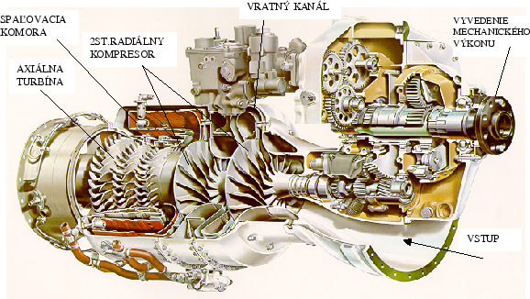
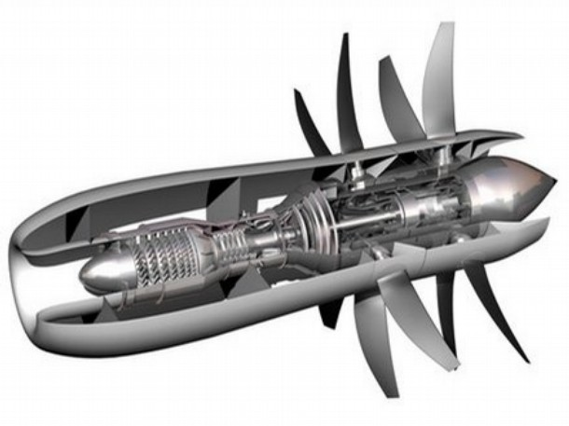
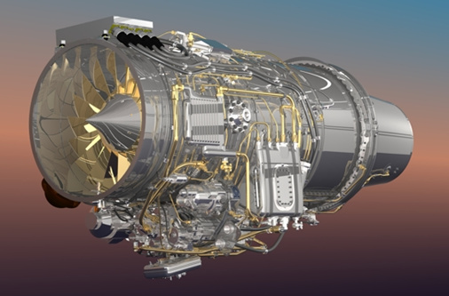
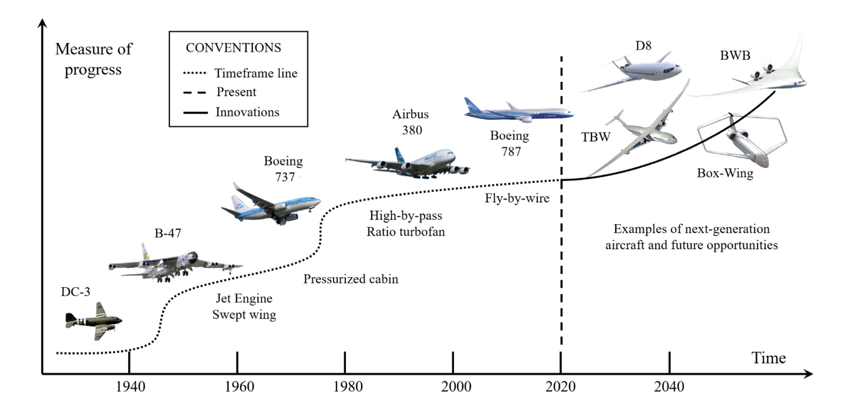

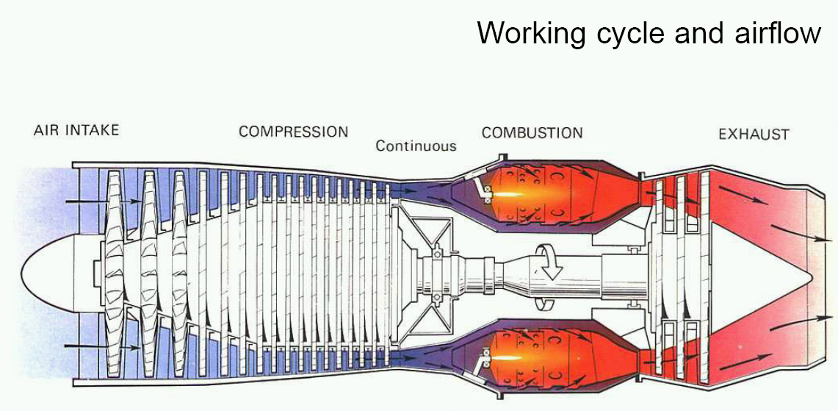
Aircraft propulsion OLE-A 12

Slide 2

Environmental requirements for aircraft engines

Slide 3
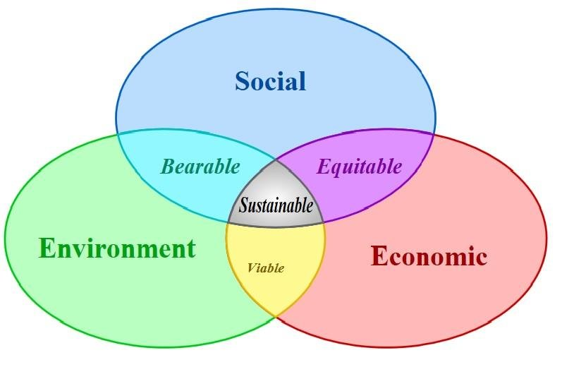
Environmental requirements
Sustainability
represents a development model that meets the needs of the present without compromising the ability of future generations to meet their own needs. It is a holistic approach that takes into account the social, environmental and economic impacts of actions and decisions taken today.
Society
human rights
democracy
equal opportunities
infrastructure
Economic
profit, sales, costs
shareholder value
market share
Enviroment
resources and
pollution
biodiversity

Slide 4
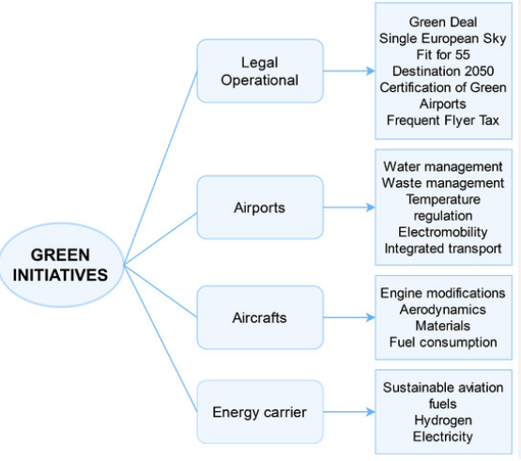
Environmental requirements
Sustainability
Elements that should enable the aviation industry to achieve sustainability
Paris Climate Agreement2015
ICAO CORSIA
EU Fit for 55
EU Emission allowances
Frequent traveler taxes……
Legislation
Nakládání s odpady
Elektrifikace pozemního odbavení
Integrovaná doprava
Propojení s rychlovlaky
……
Waste management
Electrification of ground handling
Integrated transport
High-speed rail connections
……
sustainability elements
Airport
Aircraft
High efficiency aircraft propulsion
New aerodynamic concepts
New materials
Fuels
Sustainable Fuels SAF
Hydrogen
Electrification

Slide 5
Environmental requirements
Global climate change
Climate change, including global warming, has been occurring since the beginning of the 20th century.
In the second half of the 20th century, the intensity of higher average annual global temperatures has increased.
According to scientists, the increase in average global temperatures is strongly influenced by human activities and emissions of greenhouse gases, especially CO2.
CO2 is produced by the combustion of hydrocarbon fuels.
Air transport contributes 2-3% to emissions and this ratio is growing as land transport decarbonizes..

Slide 6
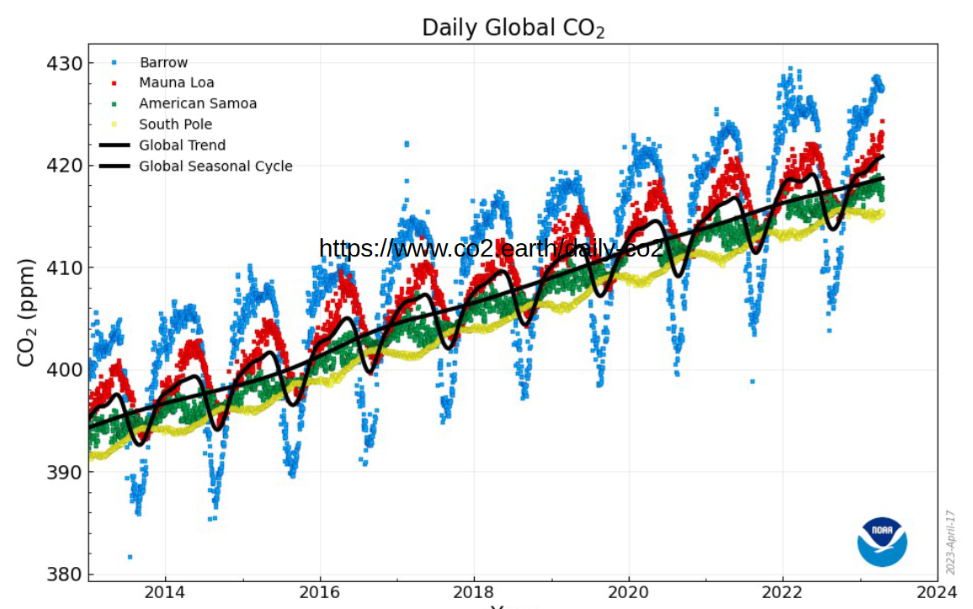
Environmental requirements
Global climate change
Projevy klimatické změny
Sucha
• Nebývale horká, případně i vlhká (či v zimě teplá) období
• Požáry přesahující lidskou paměť – jako Lytton v Kanadě
• Bezprecedentní povodně, záplavy, potopy
• Srážky vedoucí k devastujícím sesuvům
• - v tropech i v důsledku silnějších hurikánů, spolu s větrem
• Pády horských svahů, doposud pojených ledem
• … a mnoho dalších případů mizení permafrostu
• Změněný chod počasí, likvidující dosavadní zemědělství

Slide 7
Environmental requirements
Strategies and activities supporting the sustainability of air transport
Rio de Janeiro 1992, UN Framework Convention on Climate Change signed
The Parties to the Convention have committed to:
inventory their greenhouse gas emissions;
implement national programs aimed at reducing emissions;
support the development of relevant technologies;
support scientific research, public education, exchange of information.

Slide 8
Environmental requirements
Strategies and activities supporting the sustainability of air transport
Paris Climate Agreement 2015
The 2015 Paris Climate Agreement is a legally binding international treaty adopted by 196 parties at the UN Climate Change Conference (COP21) to combat climate change. Its main goal is to limit global warming to well below 2°C above pre-industrial levels, while aiming for a 1.5°C limit. The agreement requires countries to set their own greenhouse gas reduction targets, adapt to climate change impacts, and provide financial support to developing nations.

Slide 9
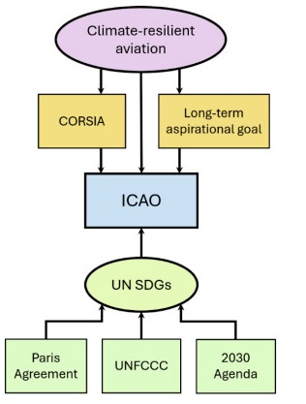

Environmental requirements
Strategies and activities supporting the sustainability of air transport
The UN 2030 Agenda for Sustainable Development identifies aviation as an integral part of achieving several Sustainable Development Goals (SDGs),
UNFCCC - United Nations Framework Convention on Climate Change

Slide 10
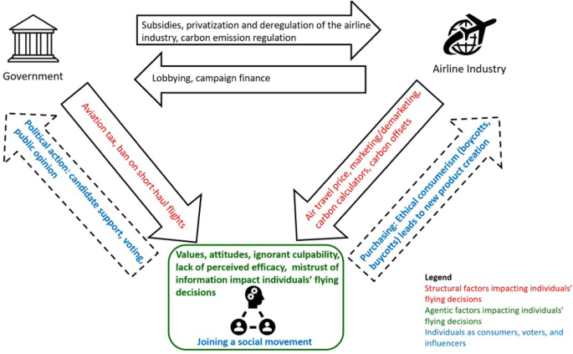
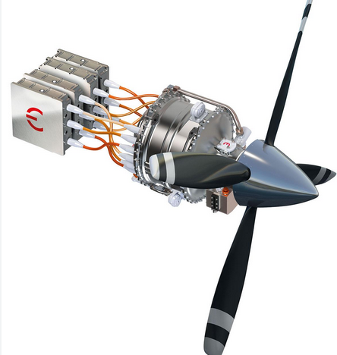
Environmental requirements
Strategies and activities supporting the sustainability of air transport
Aircraft propulsion manufacturer
Kjótský protokol 1997,
Mezinárodní smlouva k Rámcové úmluvě OSN o

Slide 11
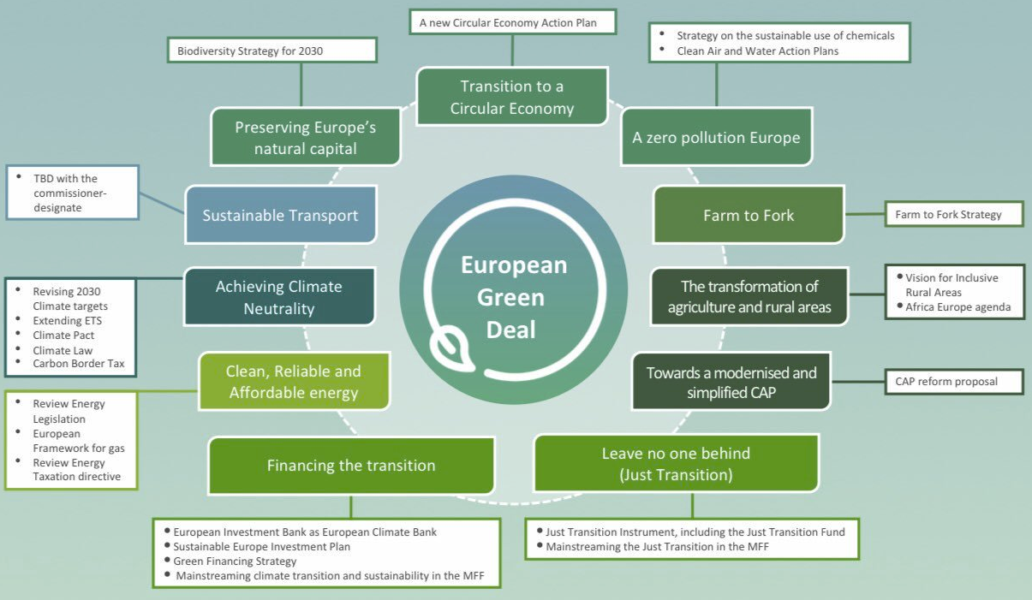
Environmental requirements
Strategies and activities supporting the sustainability of air transport

Slide 12
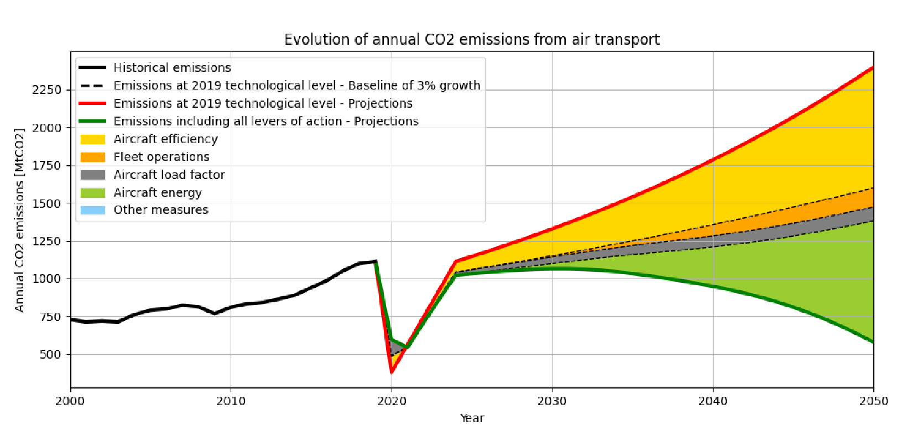
Environmental requirements
Strategies and activities leading to sustainability of the aviation industry

Slide 13
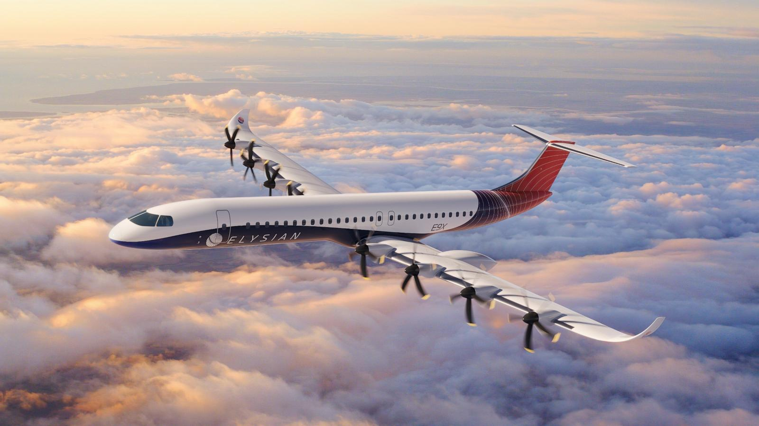
Emissions produced by an aircraft engine.

Slide 14
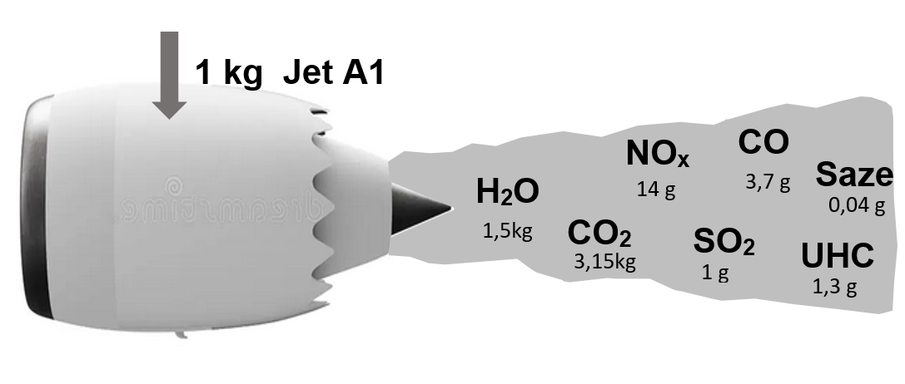
Emissions created by aircraft turbine propulsion
Characteristic emissions of JET A1 combustion
Burning 1kg of aviation fuel produces the following emissions:
279 million tons of jet fuel were consumed in 2023

Slide 15
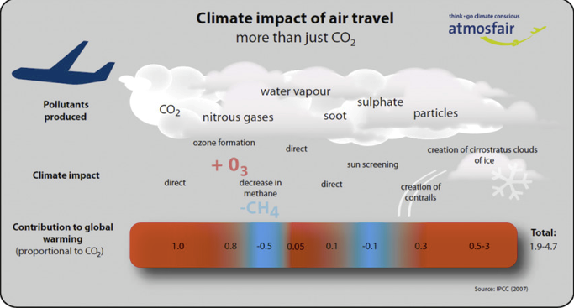
Emissions created by aircraft turbine propulsion
Impact of aviation emissions
To assess the impact, the GWP radiative forcing potential indicator was introduced, which expresses the potential contribution of a given gas to the greenhouse effect compared to the CO2 reference value.
Průměrné množství vypuštěných emisí na 1 kg spáleného paliva Jet A1 a GWP faktor

Slide 16
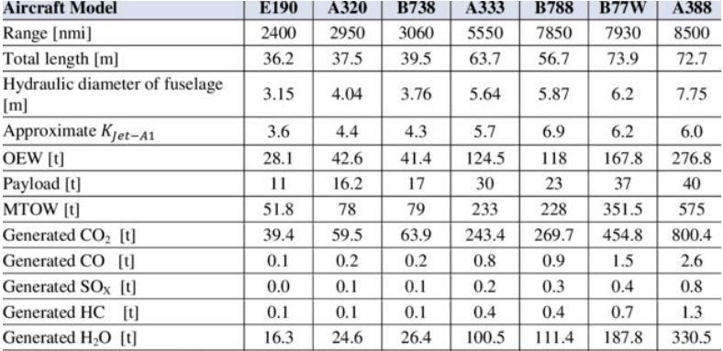
Emissions created by aircraft turbine propulsion
Impact of aviation emissions
Comparison of emissions of different types of transport aircraft.
Průměrné množství vypuštěných emisí na 1 kg spáleného paliva Jet A1 a GWP faktor

Slide 17
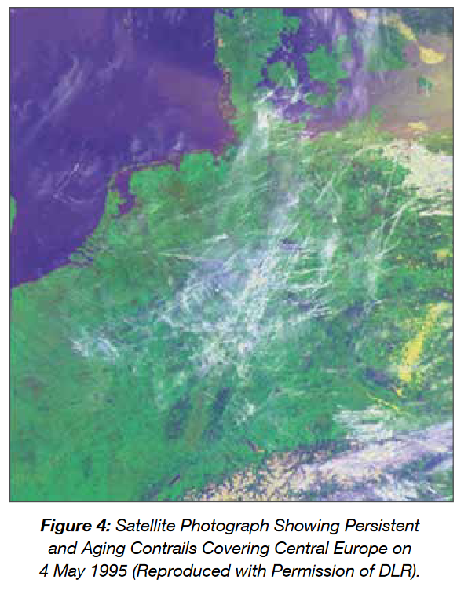
Emissions created by aircraft turbine propulsion
Impact of aviation emissions
Cirrus clouds formed from condensation trails under specific meteorological conditions that can contribute to warming

Slide 18
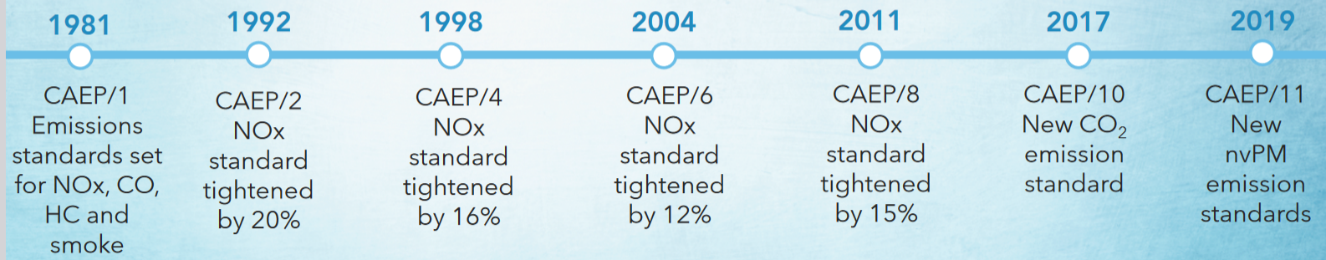
Emissions created by aircraft turbine propulsion
Limiting aircraft engine emissions by standards
Timeline for the introduction of regulatory restrictions on emissions and noise produced by aircraft engines
In 2016, ICAO also set emission standards for CO2 production, which was introduced by the CAEP/10 standard. The standard also applies to aircraft already in production and those that have already received certification.

Slide 19
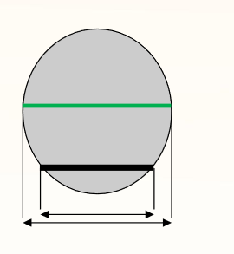
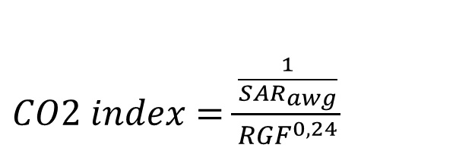
Emissions created by aircraft turbine propulsion
Limiting aircraft engine emissions by standards
CO2 index calculation:
Where: RGF is the dimensionless Reference Geometric Factor, which is determined for a single-deck aircraft as the surface area (expressed in m2) bounded by the maximum width of the outer fuselage line projected onto a plane parallel to the floor of the main deck between the forward and aft bulkheads of the passenger compartment, excluding the cockpit and crew compartment.
The value 1/SAR_{awg} is evaluated as the average of the maximum specific range under optimal conditions for three different total weights GW in (kg), which are defined as follows:
High Gross Weight (GW) = 0,92 * MTOW
Medium GW = Průměr z vysoké a nízké GW
Low GW = 0,45 * MTOW + 0,63 * MTOW 0,924
$CO2 index=\frac{\frac{1}{{SAR}_{awg}}}{{RGF}^{0,24}}$

Slide 20
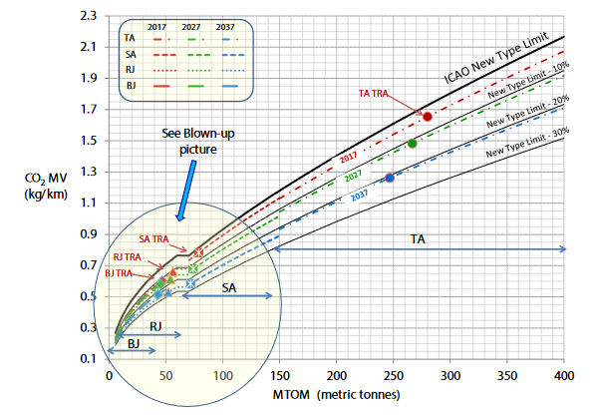
Emissions created by aircraft turbine propulsion
Limiting aircraft engine emissions by standards
Determination of CO2 index by combining metric value and MTOW weight:

Slide 21
Electric aircraft propulsion units

Slide 22
Electric aircraft propulsion units
Electric propulsion of aircraft is not a revolutionary technology.
The problem is the source of electrical energy.
Advances in battery technology are enabling the realization of usable propulsion for the lightest aircraft.
The advantage of electric propulsion is the high efficiency of energy conversion and the possibility of its production in a sustainable way

Slide 23
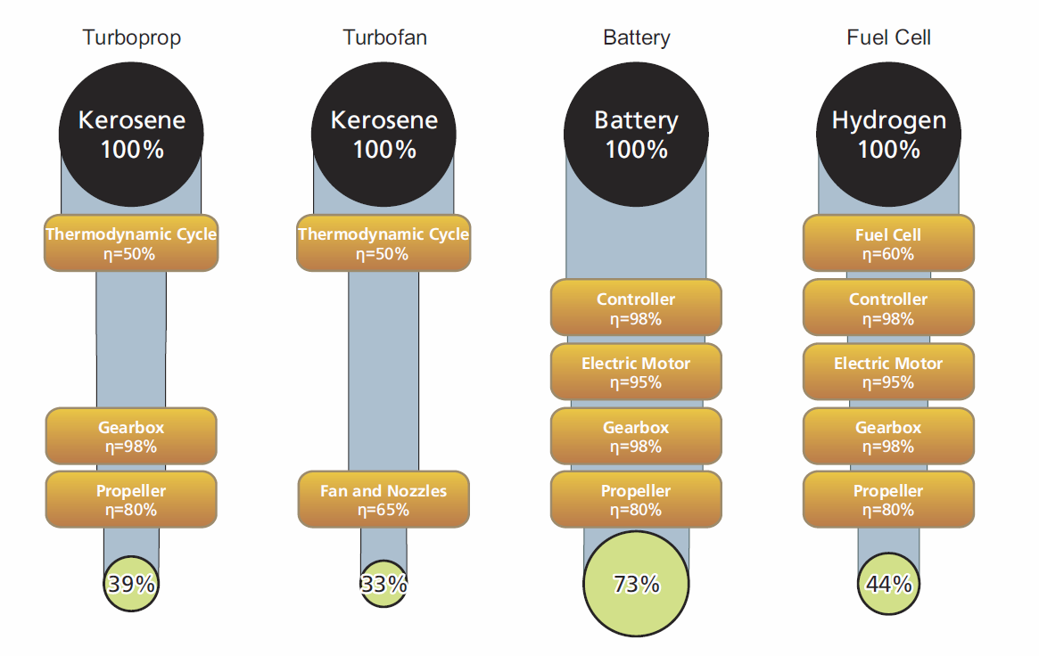
Electric aircraft propulsion units
Comparison of the efficiency of different propulsion systems.

Slide 24
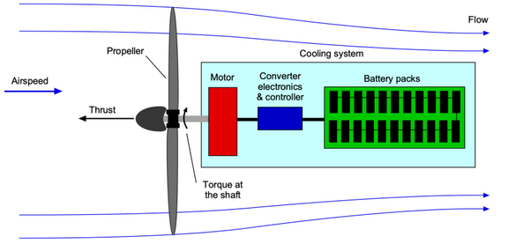
Electric aircraft propulsion units
Basic components of an electric propulsion system
In principle, an electric propulsion system consists of an electric motor that drives a propeller (or Fan).
The use of voltage converters to control the motor power and the energy source is essential.

Slide 25
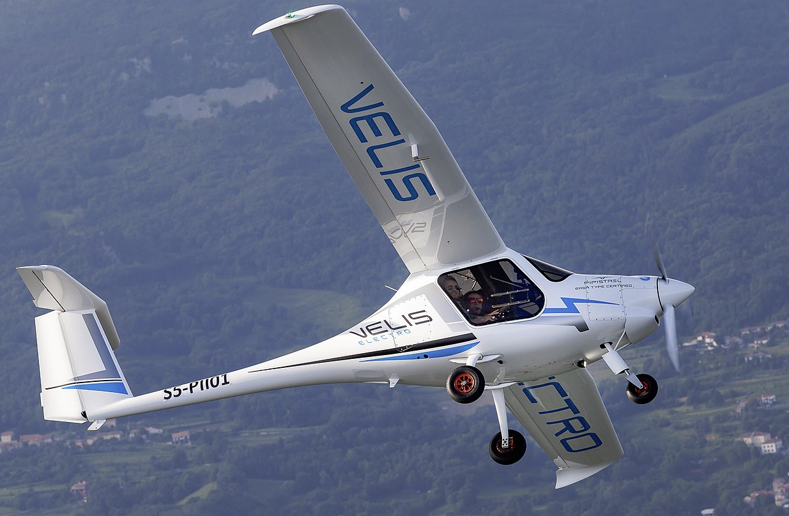
Electric aircraft propulsion units
The Velis Electro is the first electric-powered ultralight aircraft to receive EASA certification. With two 20kWh/70kg batteries, it is capable of flying for approximately 50 minutes.

Slide 26
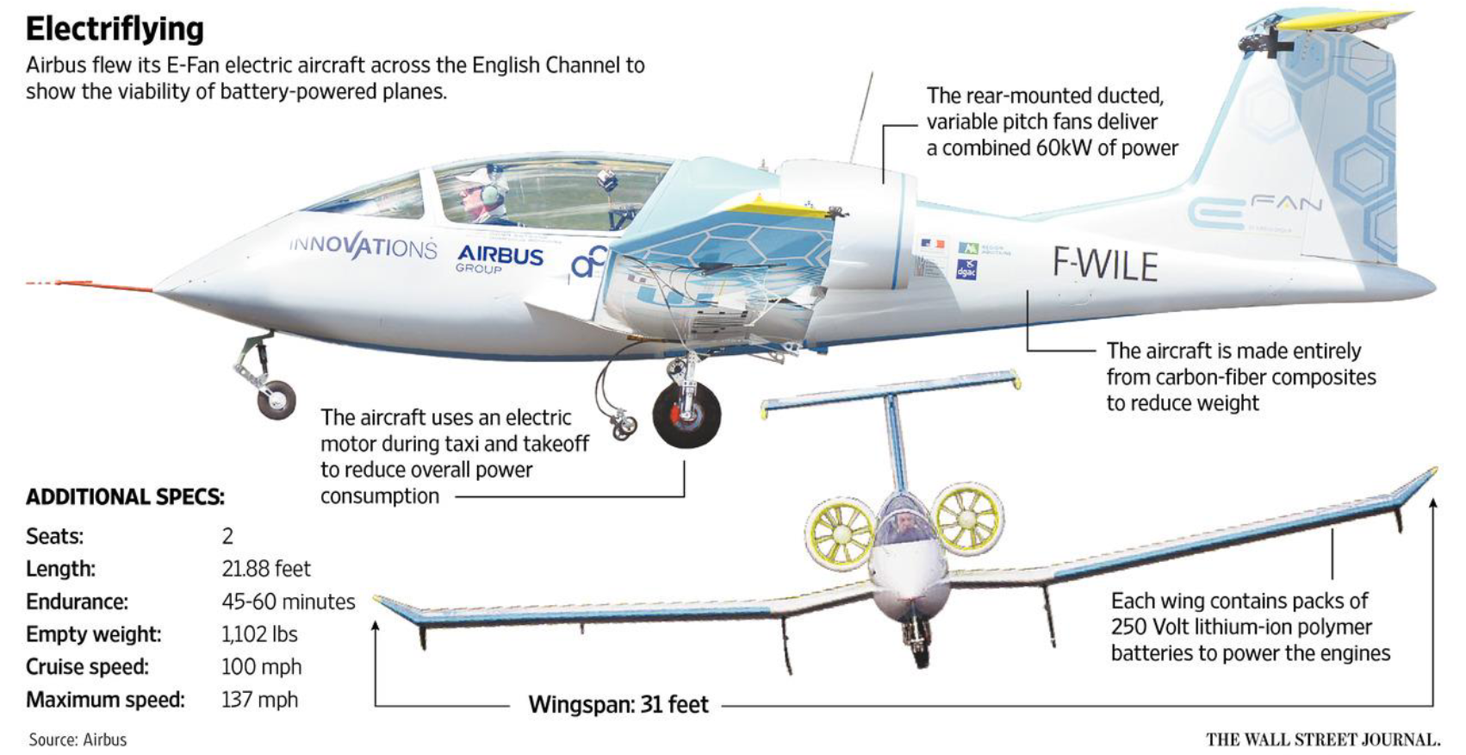
Electric aircraft propulsion units
Experimentální letadla Airbus E-Fan
160 km/h
220 km/h

Slide 27
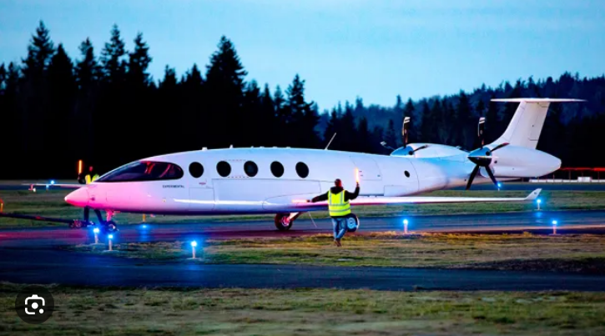
Electric aircraft propulsion units
Experimentální letadla - Eaviation Alice
The most advanced project so far is a 9-passenger electric passenger aircraft with a range of 400 km.

Slide 28
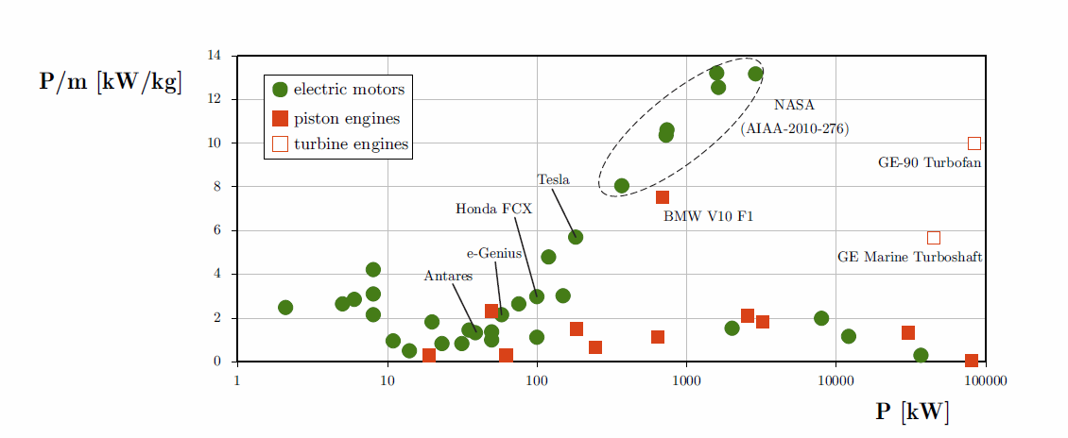
Electric aircraft propulsion units
Power density of electric motors for transport aplication
Porovnání měrná hustoty výkonu současných pístových a turbínových motorů s elektromotory.

Slide 29
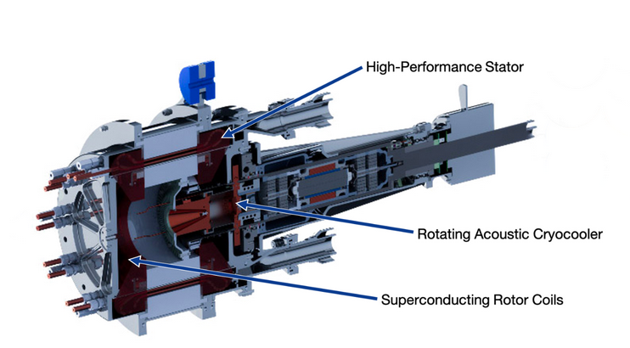
Electric aircraft propulsion units
NASA project High-Efficiency Megawatt Motor HEMM
Electric motors for aircraft propulsion require a specific design.
The use of superconductors is being considered. Liquid hydrogen and fuel cells are expected to be the energy source. The low temperature of liquid hydrogen can be used to cool superconductors and in this way the energy spent on liquefying hydrogen can be used
Project to develop a 1.4 MW engine for electrified aircraft propulsion.
HEMM aims for a power density of 16 kW/kg, an efficiency of 99%

Slide 30
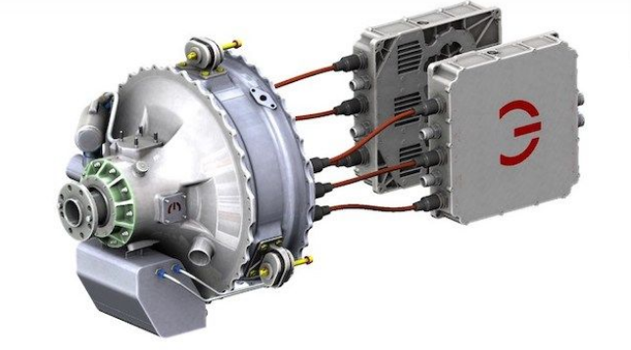
Electric aircraft propulsion units
Conventional electric motor designs – available on the market
Magni EPU
Example: Magni350 engine, power 350 kW / 1600 Nm, in the magniDrive-100 electric control system - 170kW inverter/engine control unit, is duplicated for higher reliability.
It has been used in a number of aircraft electrification projects.

Slide 31
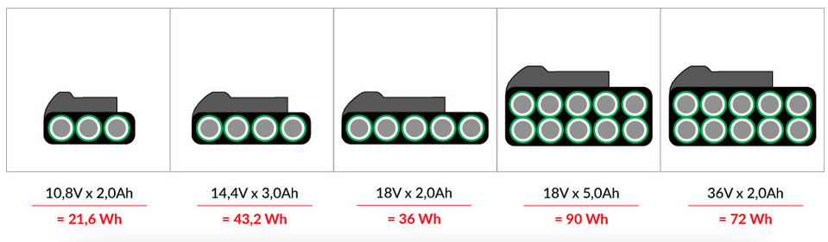
Electric aircraft propulsion units
Electrical energy sources
DC voltage sources:
Battery (primary cell): Provides energy immediately after assembly and is usually not rechargeable.
Rechargeable battery (secondary cell): Can be recharged and used repeatedly.
Fuel cells: directly convert the chemical energy of the fuel and oxidant into electrical energy.
The basic parameter of a DC source is the available capacity in Ah and energy in Wh.

Slide 32
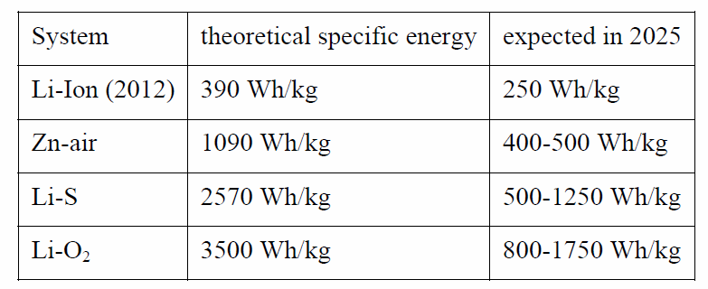
Electric aircraft propulsion units
Batteries
Efficiency is limited by the chemical processes occurring during charging and discharging. The cell voltage is limited to 1 – 4V and the current density is also limited by the chemical system.
In most cases, the weight of the battery system usually does not change, except for some specific cells that use air, e.g. Li-O2.
experimenty

Slide 33
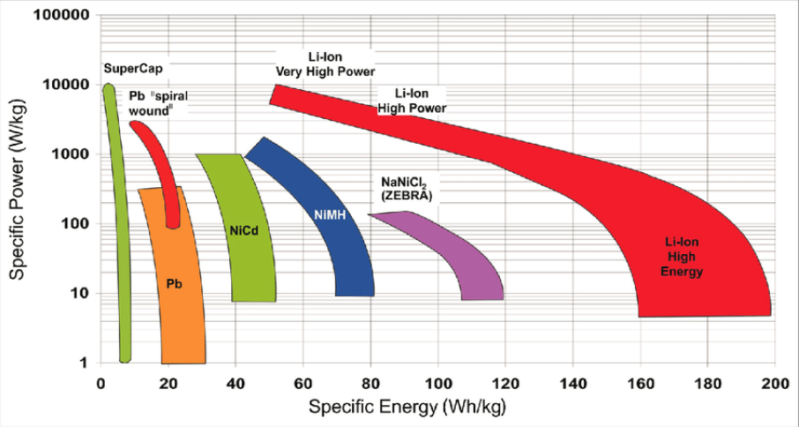
Electric aircraft propulsion units
Overview of parameters of existing batteries
.

Slide 34
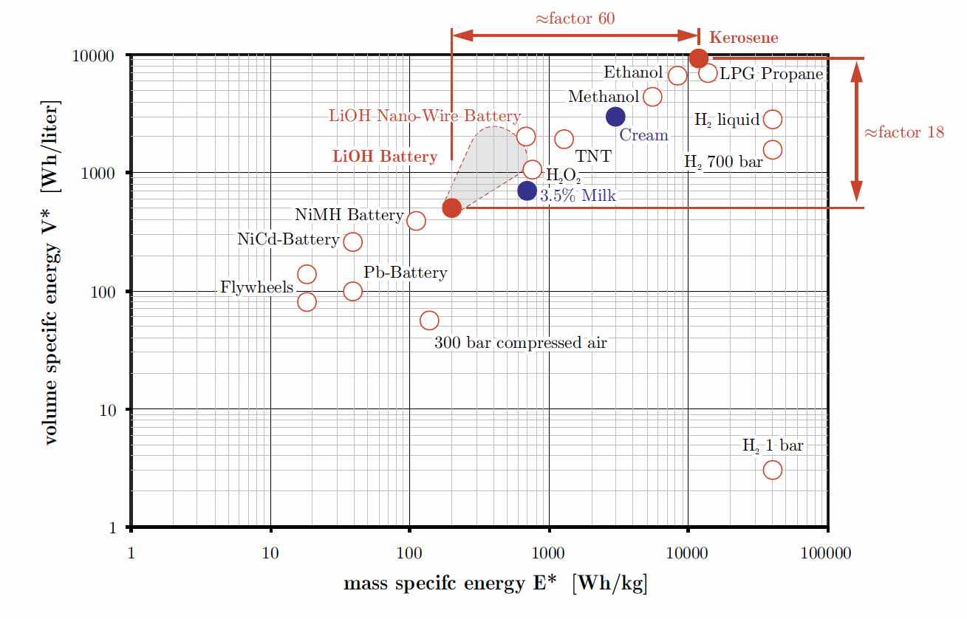
Electric aircraft propulsion units
Volumetric and mass energy characteristics of various energy storage systems
.

Slide 35
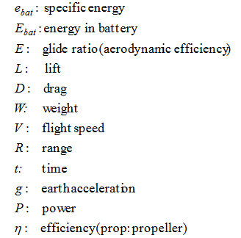
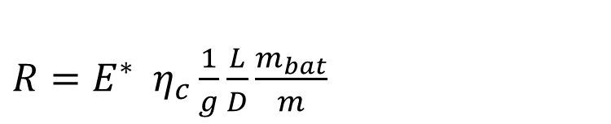
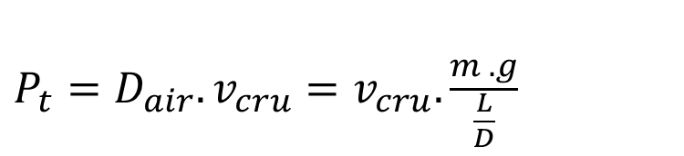
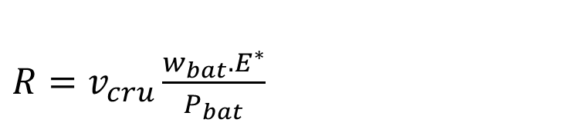

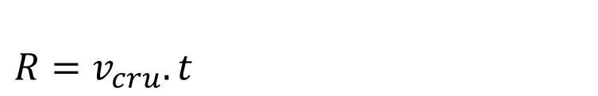
Electric aircraft propulsion units
The impact of the battery on the range of an electric aircraft
$t=\frac{w_{bat}.E^{∗}}{P_{bat}}$
$R=v_{cru}.t$
$R=v_{cru}\frac{w_{bat}.E^{∗}}{P_{bat}}$
Power required for horizontal flight:
$P_{t}=D_{air}.v_{cru}=v_{cru}.\frac{m . g}{\frac{L}{D}}$
E* = e_{bat} (kWh/kg),
$R=E^{∗} η_{c}\frac{1}{g}\frac{L}{D}\frac{m_{bat}}{m}$
! – simplified considerations, the influence of take-off, climb, discharge characteristics is not considered, Reality is about 20% worse!!!

Slide 36
Electric aircraft propulsion units
Analysis conclusions:
range is independent of flight speed v_{cru}, but of mass ratio m_{bat}/m higher mass = more energy
It is necessary to increase::
ratio of battery weight to total aircraft weight,
specific capacity E* ,
lift/drag ratio
overall system efficiency (from battery to final thrust force )
Electric aircraft require a different conceptual approach. A simple conversion of existing aircraft is not suitable

Slide 37
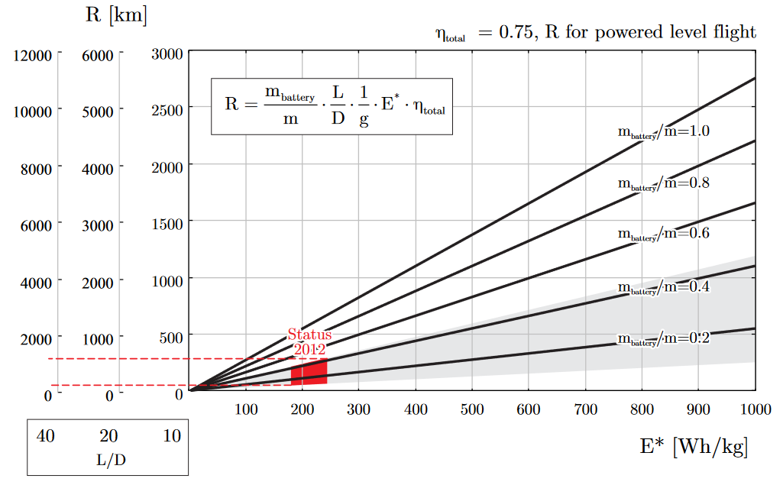
Electric aircraft propulsion units
Influence of battery parameters on flight range
.

Slide 38
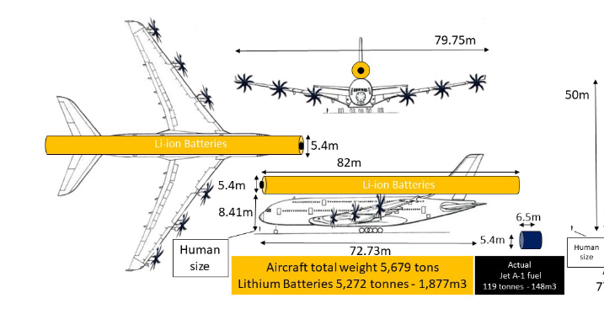
Electric aircraft propulsion units
Attempt to electrify the A380 with current batteries .. FAIL
The increase in weight and power requirements creates an insoluble problem
https://www.eurocontrol.int/sites/default/files/2023-08/eurocontrol-think-paper-21-long-haul-decarb.pdf

Slide 39
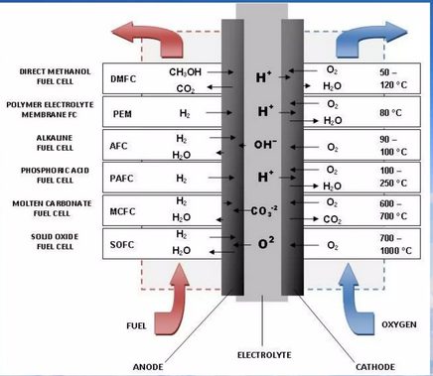
Fuel cell
Possible fuel and oxidizer combinations for fuel cells systems.

Slide 40
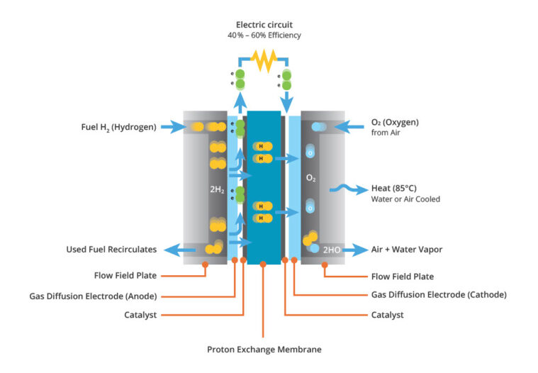
Hydrogen propulsion
Hydrogen fuel cell
Basic working diagram of a PEM type fuel cell

Slide 41
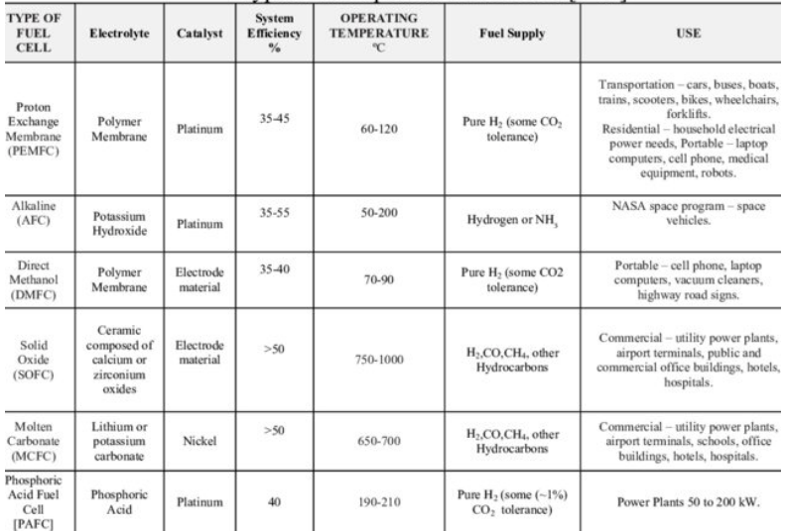
Fuel cell
Hydrogen fuel cell
Overview of the advantages and limitations of various fuel cell systems.

Slide 42
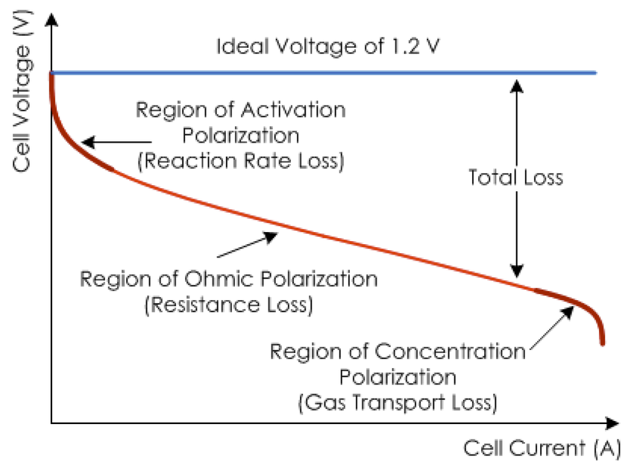
Fuel cell
Hydrogen fuel cell
Ideal and actual V-I characteristics of the PEM fuel cell (PEMFC)

Slide 43
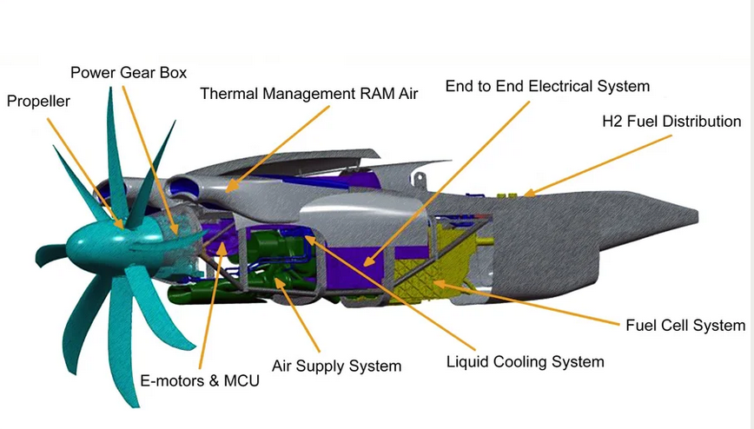
Fuel cell
Hydrogen fuel cell
Airbus' vision of a fuel cell powertrain, the Gondola contains a 2MW electric motor, an associated engine control unit, a fuel cell system to power the engine, and associated systems to deliver air, hydrogen fuel, liquid coolant, and other necessities. A thermal management system would capture the cold blast air flowing around the aircraft.

Slide 44
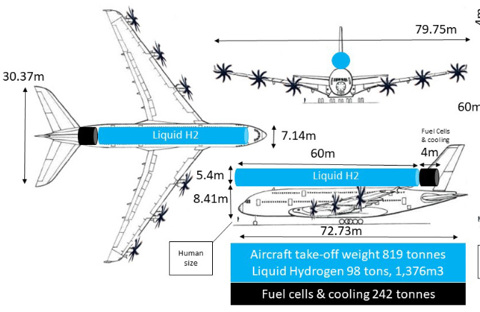
Fuel cell
Hydrogen fuel cell implementation on the A380
https://www.eurocontrol.int/sites/default/files/2023-08/eurocontrol-think-paper-21-long-haul-decarb.pdf

Slide 45
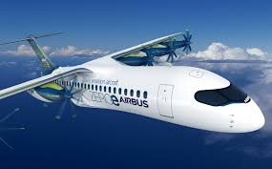
Hydrogen aircraft propulsion

Slide 46
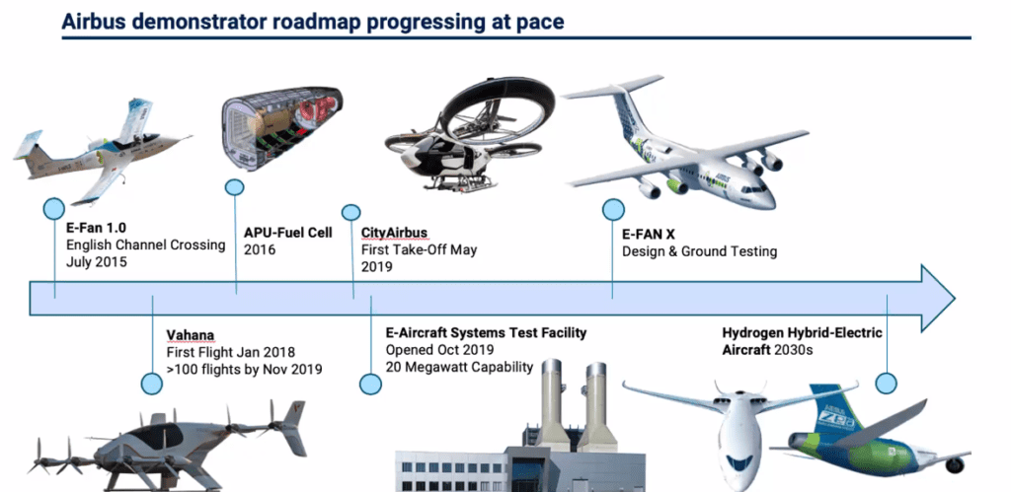
Hydrogen aircraft propulsion
Airbus' vision for hydrogen propulsion
.
?

Slide 47

Hydrogen aircraft propulsion
Properties of a hydrogen fuel
Hydrogen propulsion with a gas turbine is intended to help with the decarbonization of civil aviation. A key challenge is integrating large liquid hydrogen tanks into aircraft, given the low density of liquid hydrogen. Hydrogen offers a quarter of the energy content per unit volume and one third of the fuel weight compared to conventional fuel.

Slide 48

Hydrogen aircraft propulsion
Direct combustion of hydrogen in a turbine engine
Tested since 1957
Tu 155 was a demonstrator based on the civil Tu 154, 1988
Feasible, but H2 storage and efficiency are issues
Lack of cheap sustainable hydrogen source

Slide 49

Hydrogen aircraft propulsion
Direct hydrogen combustion
Hydrogen powered A-380
Tu 155 byl demonstrátor založený na civilním Tu 154, rok 1988
Proveditelné, problém je uložení H2 a efektivita
Chybí zdroj levného udržitelného vodíku
https://www.eurocontrol.int/sites/default/files/2023-08/eurocontrol-think-paper-21-long-haul-decarb.pdf

Slide 50

Hydrogen aircraft propulsion
However, in the case of a methane leak, the enviromental impact can be 30 to 82.5 times higher than that of CO2.
Hydrogen combustion
Methan powered A-380
Tu 155 byl demonstrátor založený na civilním Tu 154, rok 1988é, problém je uložení H2 a efektivita
Chybí zdroj levného udržitelného vodíku
https://www.eurocontrol.int/sites/default/files/2023-08/eurocontrol-think-paper-21-long-haul-decarb.pdf

Slide 51

Hydrogen aircraft propulsion
Hydrogen fuel tank
Generally, 3 times the volume of tanks is needed, which must withstand overpressure of up to 2 bars and must be thermally insulated.
Airbus' hydrogen tank vision

Slide 52
Hydrogen aircraft propulsion
Hydrogen fuel tank
The gravimetric efficiency of a hydrogen tank is the ratio of the mass of hydrogen stored to the total mass of the tank system, including the hydrogen itself, the tank structure, insulation, and other components.
Higher gravimetric efficiency is desirable, especially for weight-sensitive applications such as aviation, as it allows more hydrogen to be carried for a given weight of the tank system, increasing range and payload.

Slide 53
Hydrogen aircraft propulsion
Hydrogen fuel tank
The simplest is compressed H2. However, the storage density is low compared to other methods.
Liquid H2: 25% to 45% of the stored energy is needed to liquefy H2. In this method, the storage density of hydrogen is very high, but hydrogen boils at around -253°C and this low temperature must be maintained (otherwise the hydrogen will evaporate) and bulky insulation is required.
Metal hydride storage involves the absorption of hydrogen by powdered metals under high pressure. During this process, heat is generated when the pressure is added, and the process is reversed when the pressure is released and heat is applied. The main problem is the weight of the absorption material - the weight of the tank would be about 7-8 kg higher than that of a comparable tank with compressed gaseous H2.

Slide 54

Hydrogen aircraft propulsion
Defferent methods of storage of H2

Slide 55



Hydrogen aircraft propulsion
Possible methods of storage of H2 on board the aircraft
In the fuselage
Under the wings

Slide 56

Hydrogen aircraft propulsion
Hydrogen Fuel cell
Comparison of the efficiency of different drivechain types
Direct storage of electrical energy in a battery is the most efficient - the problem of insufficient capacity can be solved by a fuel cell.

Slide 57
Seminar 12

Slide 58
Seminar 12 Analysis of aircraft propulsion efficiency
Analysis of aircraft propulsion efficiency
Task:
Analyze the overall efficiency of the propulsion system of the given airliner:
Determine the specific range and specific impulse of the propulsion system
What impact will a 10% increase in propulsion efficiency have on the specific range?
Typ | MTOW (kg) | OWE (kg) | Wing area (m2) | Cruise speed (km/h) | Payload (kg) | Propulsion power (kW) | Range (km) | Fuel capacity (litres ) | L/D ratio Optimal
Airbus A340 -500 | 376 000 | 72 850 | 439,4 | 907 | 43300 | 9165 | 16100 | 222 850 | 18.1
Airbus A380 -800 | 560 000 | 276 800 | 846 | 945 | 66 400 | 12 246 | 15 200 | 320 000 | 19.36
For simplicity, mean values ​​of variable parameters will be considered

Slide 59






Seminar 12 Analysis of aircraft propulsion efficiency
Range:
Reduct 15% of the fuel for takeoff and landing and as a reserve
.
$R=V.t_{f}=V . \left(\frac{L}{D}\right). I_{sp} . ln\left(\frac{W_{i}}{W_{f}}\right)$
$$w_{i}=MTOW$$
$$w_{f}=MTOW−\left(m_{fuel }.0,85\right)$$
$I_{sp} =\frac{R}{v_{cruise}\left(\frac{L}{D}\right)ln\left(\frac{W_{i}}{W_{f}}\right)}$
$I_{sp} =\frac{T}{g\dot{m_{fuel}}}$
8350 kg / hod
297 kN tah = 74,3 MJ tah výkon
Specific air range :
$SAR=\frac{R}{m_{f}}\left[\frac{NM}{lb fuel}\right]\left[\frac{km}{kg paliva}\right]$

Slide 60



Seminar 12 Analysis of aircraft propulsion efficiency
Overall Efficiency
.
$$\text{O}\text{ver}all efficiency=\frac{Thrust power }{Supply power }$$
74,3 MJ tah výkon
$$η_{overall}=\frac{T.v_{flight}}{\dot{m_{fuel}h}}$$
99,7 MJ = 74,3%
$$η_{overall}=η_{thermal}{.η}_{propulsive}$$

Slide 61

This output was supported by the National Recovery Plan project "Acceleration of Green Skills and Sustainability at BUT " registration number NPO_VUT_MSMT-2143/2024-5.
CC BY-NC-SA 4.0

